Slide 1
SYMBOLIC INTERACTION, NARRATIVE AND THE SICK BODY: SOME PERSONAL REFLECTIONS
FRAGMENTS OF AN ILLNESS NARRATIVE
CENTRE FOR NARRATIVE RESEARCH UEL
MARCH 23RD 2011
Ken Plummer

Slide 2
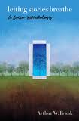
Stories animate human life: that is their work
Arthur Frank: Letting Stories Breathe

Slide 3
We tell ourselves stories in order to live
Joan Didion

Slide 4
ILLNESS IS AN OPPORTUNITY.. LIVE ACTIVELY
Arthur Frank: At the will of your body

Slide 5
My little story of ‘END STAGE ALCOHOLIC CIRRHOSIS OF THE LIVER’
Initially, a personal and therapeutic goal.
The Total Life Episode from 2004-2007.
Assembled over 3 months at the end of 2007 start of 2008
Integrated in summer of 2008: A Transplanted Life – friends commented
2009 version left
Now re-thinking…………

Slide 6
The meanings of illness
IllNESS AS TECHNICAL MEDICINE
ILLNESS AS SOCIAL ACT and narrative

Slide 7
ILLNESS AS ILLNESS IS ONE MEANING

Slide 8
THE 50 MEANINGS OF ILLNESS
So many themes of illness other than illness.........
50 to start with….

Slide 9
30 – or more – meanings of illness
1 Illness as symptom and illness | 11 Illness as body | 21 Illness as self and identity
2 illness as fateful moments | 12 Illness as story | 22 Illness as privilege and disadvantage
3 Illness as time | 13 Illness as cyborg | 23 Illness as stigma
4 Illness as space | 14 Illness as care | 24 Illness as opportunity
5 Illness as other people | 15 Illness as meetings | 25 Illness as generosity
6 Illness as uncertainty | 16 Illness as a web site | 26 Illness as joy
7 Illness as timetable | 17 Illness as everyday life | 27 Illness as dying
8 Illness as historical contingency | 18 Illness as suffering | 28 Illness as contingencies
9 Illness as altruism | 19 Illness as exploitation | 29 Illness as metaphor
10 Illness as market | 20 Illness as progress | 30 Illness as remissision

Slide 10
ERVING GOFFMAN 1922- 1982-sociologist
‘THE MORAL CAREER OF THE MENTAL PATIENT’
Psychiatry Vol. 22 May 1959. But most accessible in his book Asylums (1961, Penguin)
‘Mental patients suffer not from mental illness but from contingencies’ p126
The career links to
‘internal matters held dearly and closely... The other concerns official position..... The framework for judging himself and others...p120

Slide 11
A TRANSPLANT CAREER
Pre Patient
Patient
Post Patient

Slide 12
Illness as a ceasless flow... continual permutations of action
everything is normal
warning signs.
Crisis and diagnostic moments
getting on the list
the call......
Living with a three hour warning

Slide 13
Part 2 Illness as a ceasless flow... continual permutations of action
The rush to the hospital
Surgery – 6, 8, 12 hours...
ICU- hallucinations
Rebuilding the body.
‘born again...... ‘ without the god....
Living with a bag

Slide 14
Part 3 Illness as a ceasless flow... continual permutations of action
Back to the hospital....
The story continues.....
?????
???????
Back to the future????
???????

Slide 15
sick

Slide 16
THE MOMENTOUS MOMENT: The new LIVER

Slide 17
A few body memorializing dates turning points, ‘epiphanies’
1. 9th March 2005 FAT ‘alcoholic’ KEN
Hospitalization in Santa Barbara, diagnosis, giving up drink absolutely on that day
2. 23rd April 2006 BLOODY YELLOW ‘very sick’KEN
Hospitalization at King’s, tests and placed on the list - the well examined body
3. 18th February 2007 ON CALL KEN, ANXIOUS KEN, CYBER KEN
3.45 am. The call to King’s, surgery and intensive care
4. 23rd May 2007 BORN AGAIN KEN
Removal of bile duct drain.... ‘born again’

Slide 18
The Transplant Process the selection process: many are available, few are chosen
4. Transplant Surgery
3. The Transplant Waiting List
1. People with potentially diagnosable liver illness
5.‘Survivor’ Transplant Person
2. The Diagnosed

Slide 19
BACKGROUND: The social worlds of donor-transplant
Multiple worlds
community
nurses
doctor
Transplant Patient’s world
etc
researchers
Coordinators
Key setting of negotiation: the hospital- medical worlds, research worlds, education worlds etc.
work
family
Donor’s world
family
community

Slide 20
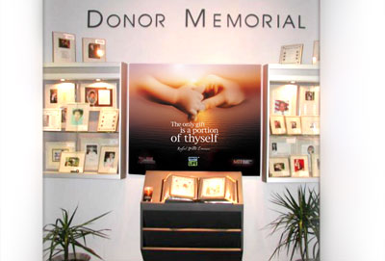

Slide 21
NO TIME TO TREAT MANY THINGS LIKE….
ALCOHOL
THE LIST THAT IS NOT A LIST
HALLUCINATIONS
ENCEPHALOPATHY
5. AFTERMATHS

Slide 22
The body and symbolic interaction
AN AUTO/ETHNGRAPHIC EXPLORATION

Slide 23
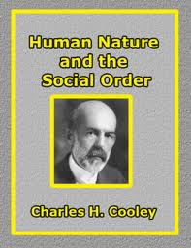
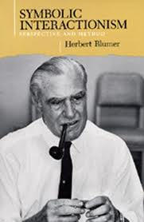
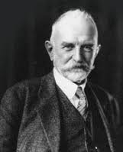
What is symbolic interactionism?
SYMBOLIC INTERACTION HAS ALWAYS HIGHLIGHTED:
SYMBOLS –narratives, meaning, perspectives, discourse PROCESS – emergence, flows, becomings, mobilities, contingencies INTERACTION – always connect with the others MORAL AND POLITICAL- the pragmatics of a better world GROUNDED- close inspection/intimate familiarity with the empirical world

Slide 24
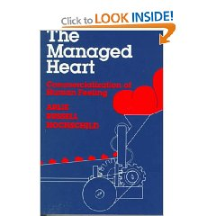
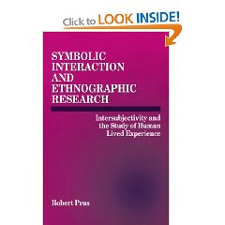
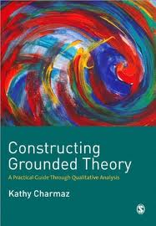
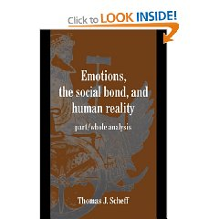
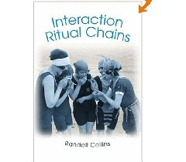
MANY NEW DEVELOPMENTS IN S.I.
SIGNIFICANCE OF
CULTURE
EMOTIONS
BODIES
PERFORMANCE
NARRATIVES
NEW STYLES OF RESEARCH

Slide 25
BODY/EMBODIMENT -Dennis Waskul & Philip Vanninis
A collection of readings
Images of body in SI
Looking glass body: reflexivity as embodiment
Dramaturgical Body: Body as performance
Phenomenological Body: Body as meaning
The Socio-Semiotic Body: Body as trace of culture
The narrative Body: Body as story

Slide 26
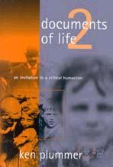
THE STORY TELLING TURN OF MY EARLIER WORK CONTINUES IN SICKNESS AND IN HEALTH….
Documents of Life-2
Telling Sexual Stories

Slide 27
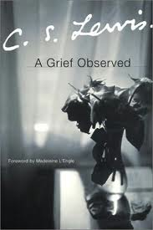

Slide 28
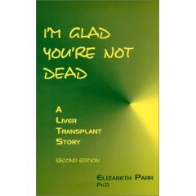
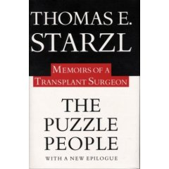
Stories of transplants

Slide 29
Narrative Medicine- some key themes
Time
Uniqueness
Causality, Contingency
Inter-subjectivity
Ethics

Slide 30
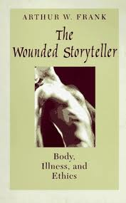
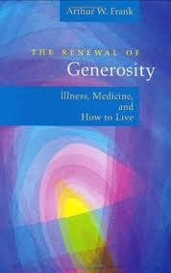
Arthur W Frank Dialogic illness

Slide 31
CELEBRITY TRANSPLANTS
GEORGE BEST (U.K)
NATALIE COLE (U.S.)

Slide 32
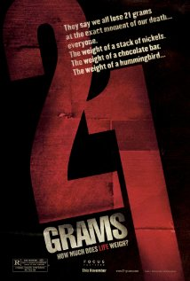
HOLLYWOOD ON TRANSPLANTS
COMEDIES
THRILLERS

Slide 33
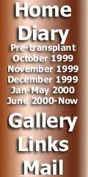
MEDIATED MEDICINE
Cybermedicine
One of my doctors on TV

Slide 34
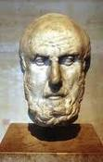
POETICS
Lavina Greenlaw ed (2007)
Hippocrates & the Four Humours

Slide 35
MY story of my MULTIPLE BODIES?
Fat, obese and black body
Thin, scary, death’s door body
Low energy, tired body
Slow, memory less body
Hospitalised sick body
Cyborged body
Out of mind body
Exhausted body
Transplanted body
Lost voice body……….

Slide 36
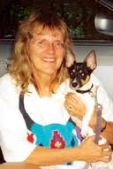
Carolyn ellis & the rise of auto/ethnography

Slide 37
Theories of body, self and emotion
An explosion of ideas over the past century
But may be too many schisms
Need to bring them all together – body, self and emotion in the lived life
Critical humanism as a starting point
Look at grounded lives
Autoethnography

Slide 38
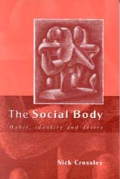
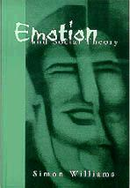
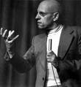
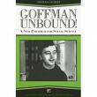

Slide 39
EMBODIMENT & THE PRAGMATIC BODY
Symbolic Interactionism | Theoretical/Philosphical issues | Emerging Ideas
SYMBOLS | MIND/BODY | MATERIAL BODY NARRATING BODY
PROCESS | CONTINUITY/ CHANGE | THE HABITUAL BODY/ THE EMERGENT BODY
INTERACTION- OTHER | INDIVIDUAL/SOCIETY | THE RELATIONAL BODY
PRAGMATIC –POLITICS /ETHICS | ABSTRACT/GROUNDED MORALITIES | THE FLOURISHING /JUST BODY
A METHODOLOGY OF INTIMATE FAMIALARITY | SCIENTIFIC DISTANCE/HUMAN ENGAGEMENT | THE GROUNDED BODY

Slide 40
THE BODY-SENSUOUS-INTERPRETIVE-SOCIAL LIFE
The
CONTINGENTLY LIVED LIFE
Bodily
‘thereness’
Interpretive acts
Sensous
presesences
Social moments

Slide 41
MY FAT, ‘OBESE’, ‘CUDDLY’, SICK BODY
Man with ascites
Woman with ascites

Slide 42
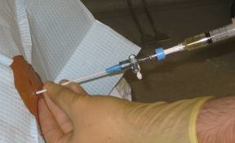
My drained body

Slide 43
MY HOSPITAL BODY: LIFE AS A SCAN

Slide 44
Thin, SMILING ken
DURING
AFTER

Slide 45
My body in the technical world of skill

Slide 46
MY MONITORED body in the sentimental order of care

Slide 47
My body in intensive care- there but for the grace of the machine...

Slide 48
The MULTIPLE MEANINGS OF THE BODY
Sick Body– Cheery Body: Ken
The cared for –even loved - body

Slide 49
THE MATERIAL SELF?
A liver is a liver is a liver
But it can take many forms
And it can go bad
Mine was 80% gone; and non restorable
It was slowly packing up

Slide 50
THE MATERIAL SURGERY

Slide 51
MORE MATERIAL THINGS

Slide 52
My body and its new MATERIAL machines
A major social experiment in social deprivation.
“Lie down. Relax.
We will leave you now!”

Slide 53
HOW TO MAKE SENSE OF THIS?

Slide 54
A BROKEN BODY

Slide 55
A battered body
All wired and plastered up
Best friends

Slide 56
Getting it back? RE-EMBODIMENT?
Rolling along!
The shower of my life

Slide 57
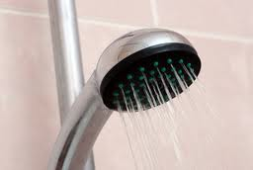
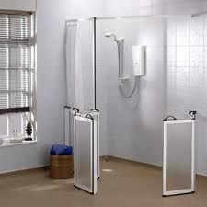
‘Putting it together’
BARBARA
SONDHEIM

Slide 58
Recreating the habitual self: CHALLENGE OF THE STAIRS

Slide 59
The relational self: the body & its signIficant others
The Living
And the Dead
MY PARTNER, EVERARD, WAS WITH ME EVERY MOMENT OF MY ILLNESS

Slide 60
THE TRANSPLANTED ‘SELF’?
How to live with the liver of someone else?
How to live with the dead?
Issues for self, body and feeling. Embodiment?
Five provisional responses ???????

Slide 61
LIVING WITH THE DEAD
1: Becoming another person
Claims are made by a few that the donor lives on in them....
Strongly refuted and no real ‘scientific’ evidence

Slide 62
LIVING WITH THE DEAD
2. Illness as
Cyborg
Hybrid
Monster –
The new metaphors of the
post humanism.

Slide 63
LIVING WITH THE DEAD
3. Living with guilt, shame, too much to live with....
Another died for me – too much…..

Slide 64
LIVING WITH THE DEAD
4. CONTINUING TO LIVE WITH ILLNESS
No respite
Career ‘Sickos’

Slide 65
LIVING WITH THE DEAD
5. ‘Born again .... with joy, thankfulness, humanity and generosity
(which can be religious)

Slide 66
THE VALUE OF MY STORIES ?
The story as an opportunity for reflection and a time for thinking
The story as the yellow brick road to the self
The story as therapy, as repair
The story as shared: its role in the world of others
The political and intellectual role of the story

Slide 67
We have each of us, a life story, an inner narrative – whose continuity, whose sense, is our lives. It might be said that each of constructs and lives a ‘narrative’, and that this narrative is our identities
Oliver Sachs
The Man who Mistook his Wife for a Hat

Slide 68
The PHOTOGRAPHIC NARRATIVE: transplant Body in ITS chair ---by laura cuch (2011)

Slide 69
THE SOLID SELF: I AM WHAT I AM
Against a whole life time of arguiong about the
MUTABLE, FRAGMENTED, HOMELESS SELF
My voice and body returned.
Deep down, for all the little other changing selves, there is a core me.

Slide 70
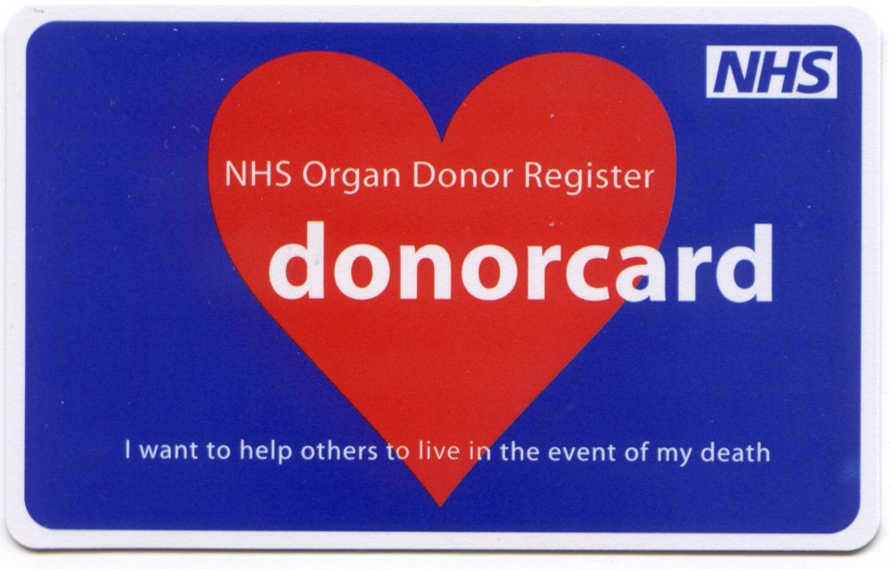

Slide 71
ORGAN DONATION
Calling the NHS Donor Line on 0300 123 23 23 (Lines are open 24 hours a day all year round. Calls are charged at your contracted rate for local calls)
By texting SAVE to 84118
STOP PRESS: Tuesday, 22 March 2011
Since 1 April 2010
982 people have donated organs
2,602 people have received transplants
7,775 people are still waiting for transplants
Source: http://www.organdonation.nhs.uk/ukt/
In the U.K.
96% of us say we would accept an organ; yet-
Only 27% of us have signed up for Organ Donation
-----
10,000 currently need a transplant:
Three people die everyday whilst waiting….
http://www.organdonation.nhs.uk/ukt/

Slide 72
With much thanks you to all
My donor – ‘Kylie’ – for her life; and her family
My hosts – King’s Hospital; the whole ’team’ that practiced skill and care on my body
My dear partner– Everard, who shared the illness for every moment (and still does)
My friends, and all the contingencies that brought me to this life..........

Slide 73
SLIDES NOT INCLUDED
Prepared but not used at UEL

Slide 75
Altruism and the market
I have always depended on the
kindness of strangers
a streetcar named desire

Slide 76
Table One: Core Features of Critical Humanism
THE STARTING IMAGERY OF HUMAN BEINGS |  | CENTRAL HUMAN CAPABILITIES (Sen and Nussbaum)
Social (never in isolation) |  | Life
Fleshy embodiment |  | Bodily health
Sensing, feeling and sensuous |  | Bodily integrity
Thinking | THE NATURE OF CRITICAL HUMANISM | Senses, imagination & thought
Selves , always in |  | Emotions
The presence of others |  | Practical reason
Dually material and symbolic |  | Affiliation
Embedded and |  | Other species
Contingent in |  | Play
Time and Space & |  | Control over one’s environment
A Matrix of Inequalities
 |  | TOWARDS HUMAN FLOURISHING

Slide 77
AN ASIDE: THE SOCIOLOGICAL IMPLICATIONS OF DONOR-TRANSPLANT (dt)
Market in body parts
The Remission society
The cyborg/ hybrids/ monster metaphor
‘The Politics of Life itself’
Altruism
The technological imperative
The micro worlds of transplantation
Intimate citizenship

Slide 78
Ken Plummer Telling Sexual Stories
The Narrative Turn in symbolic interactionism
Coming out stories
Survivor stories
Therapy stories

Slide 79
The body theorists
The body Theorists
Sociologists like Bordieu, Turner and Schilling
Feminists like Butler, Haraway and Grosz
Foucault and the focualdians
Philosphers like Merleau-Ponty
THERE IS NOW A HELL OF A LOT OF THEORY ON THE BODY OUT THERE

Slide 80
THE SELF IN FLOW
The
CONTINGENTLY LIVED HUMAN LIFE
Bodily
‘thereness’
Interpretive acts and self
Sensous
Presences
Social moments / social encounters
THE PRESENCE OF OTHERS
THE EVER NEGOTIATED SOCIAL STRUCTURE IN ACTION

Slide 81
THE EMOTION THEORISTS
The sociologists – Scheff, Goffman, Hochschild etc
Feminists – and the theory of care, violence etc Gendered emotions
Queer emotions – Ahmed etc
Focuadians – thin:

Slide 82
THE SELF THEORISTS
The classics of sociology – James, Cooley, James, Mead
The uk cultural theorists – Hall et al
The us cultural theorists – Gubrium, Gergen,
The feminist theorists- Butler et al
NOBODY SPEAKS ACROSS THEIR LITTLE WORLDS!

Slide 83
THE TASK:
To refuse the separation of body, emotion, self, thinking and the social......
Through examining grounded lived experiences.

Slide 84
Goffman and his ‘moral’ career
Internal matters
EXTERNAL MATTERS
‘held dearly and closely, such as self and felt identity... The moral aspects of career...is the regular sequences of changes that career entails in the person’s self and the framework of imagery for judging himself and others’.. p120
‘official position... part of a publicly accessible institutional complex...’
Eg the formal criteria for placing people on the transplant system ( known as the MELD or PELD scheme)

Slide 85
Orders and negotiated social orders
Anselm Strauss
Negotiated Orders
Temporal – scheduling
Technological
Informational who knows what
Sentimental order- the flow of emotions
Moral order – ethical values, norm
Aesthetic
And others..... economic, political are well known

Slide 86
memorializing dates turning points, ‘epiphanies’
9th March 2005
Hospitalization in Santa Barbara, diagnosis, giving up drink
23rd April 2006
Hospitalization at King’s, tests and placed on the list
18th February 2007
3.45 am. The call to King’s, surgery and intensive care
23rd May 2007
Removal of bile duct drain.... ‘born again’

Slide 87
CONTINGENCIES AND THE CONTINGENT LIFE
CHANCE HAPPENINGS
A JUNCTURE
SUBJECT TO ACCIDENTS
CONDITIONAL NOT ABSOLUTE
Goffman and contingency

Slide 88
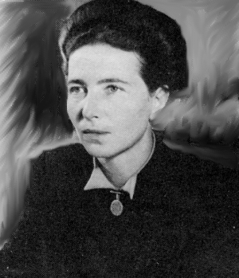
....what astonishes me..is the fact of finding myself here, and at this moment, deep in this life and not any other.... It seems to me that a thousand different futures might have stemmed from every single movement of my past....
Simone de Beauvoir
On contingency
In All Said and Done

Slide 89
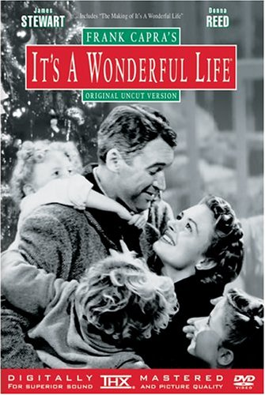
the contingencies of life
‘Each man’s life
touches so many other lives. If he wasn’t around it would leave an awful hole...’
Clarence, the angel to George Bailey

Slide 90
CONTINGENCY IN FILM

Slide 91
Contingencies and the contingent life?
life as one long series of contingencies!
life is one damn thing
after another
fateful moments
TIME
SPACE
RESOURCES
PEOPLE
STIGMA
etc

Slide 92
The contingencies of time: when were you born?
Transplantation: a success story (like so many ) of the twentieth century?
1905 : first successful cornea transplant by Eduard Zirm
1954: first successful kidney transplant
1963: world’s first liver transplant-not a success
1966-7: the year of first successful transplants- pancreas (1966), liver (1967) and heart (1967). ‘Christian Barnard’ becomes a household name.
Today: in the UK, 2006-7, there were 3,086 organ transplants and 1,495 donors
647 liver transplants in UK.
http://www.uktransplant.org.uk/

Slide 93
The contingent historical moment
AT ANY PREVIOUS MOMENT IN HISTORY, I WOULD BE DEAD BY NOW.....

Slide 94
The contingencies of space: where are you born?
 | Kidney | Liver | Heart
USA | 52 | 19 | 8
EUROPE | 27 | 10 | 4
ASIA | 3 | 0.3 | 0.03
LATIN AMERICA | 13 | 1.6 | 0.5
Source: Global alliance in Transplantation
transplant-soc.org

Slide 95
the contingencies of resources and privilige
The resources of:
BODY – prior health etc
ECONOMICS –funds etc
SOCIAL – friends etc
CULTURAL –knowledge
SELF – past history etc

Slide 96
Social resources: illness as people
“At the very heart of my illness was my partner, Everard.. in many ways it was a joint illness ......he was always there everyday of my illness, never more than a minute away from me... Every ill person needs their Everard..
But from Everard rippled out a small but central core of friends and family who rapidly became apparent......”
(people who need people are the luckiest people in the world.. tra, la, la: eat your heart out Barbra Streisand!)
My notes: Illness as other people, p29

Slide 97
ILLNESS AND EVERYDAY LIFE
“Step by step, my illness took over my life......it is the medical metamorphosis of everyday life....serious illness shifts the banality of everyday life into a new plane...
The ill come to live in a different key. Ultimately all daily activities are transformed, little of the old world is left. Even the spaces the ill move in get reassembled.....”
THE TOTAL LIFE EPISODE
(p41 of current illness story)

Slide 98
We tell stories in order to live

Slide 99
 | POSITIVE | NEGATIVE
MUCH CHANGE | THE NEWLY BORN | THE MONSTER
LITTLE CHANGE | THE JOYFUL | THE GUILTY

Slide 100
Vomiting | lethargy
Encepho | Problems with blood clotting
The shivers | Ascites
Loss of memory | Low immune etc
Halluications
Itches
Loos of weight

