Slide 1
Moodle and Turnitin for External Examiners
Kevin Pike
Learning Technology Advisor
CELT

Slide 2
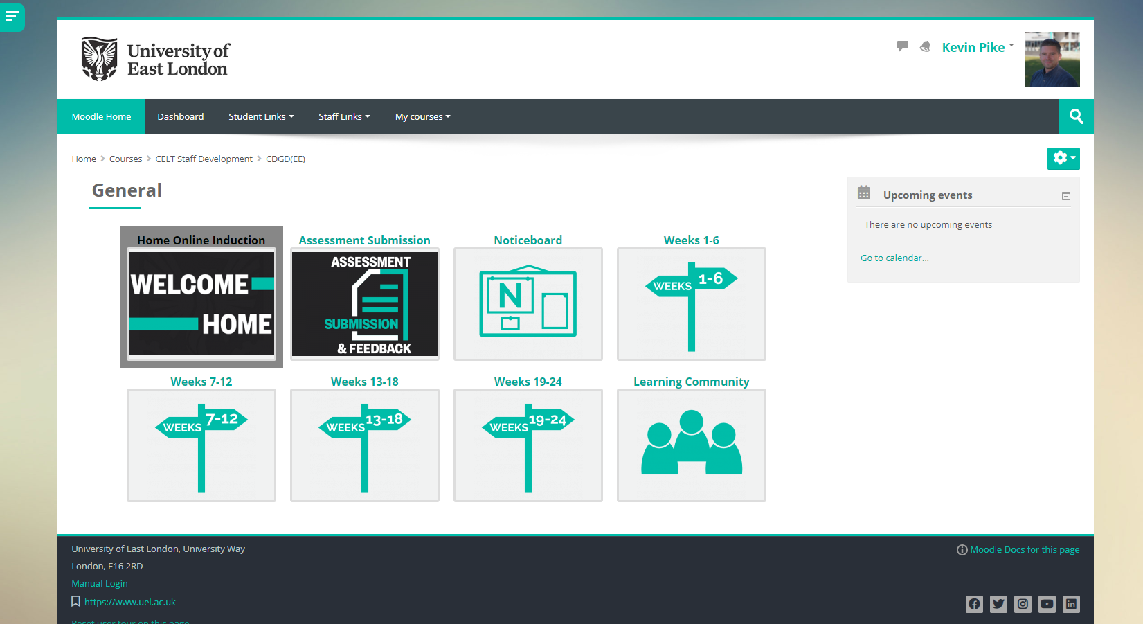
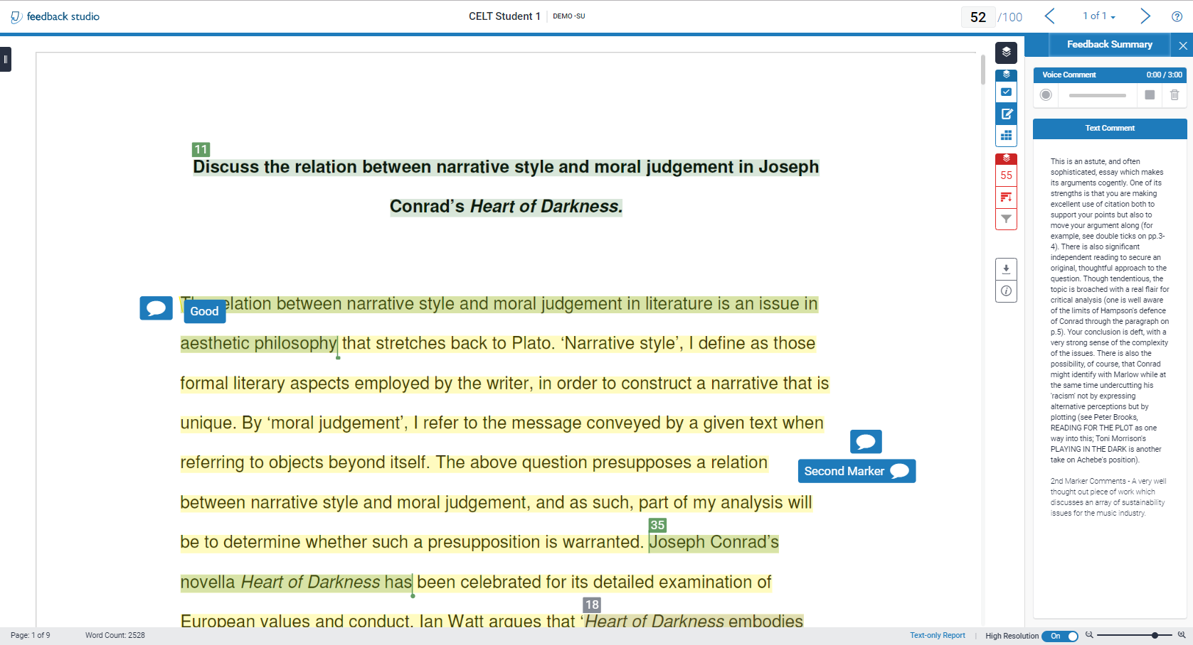
Examples
External Examiners site
New Moodle course design
External Examiners folder
Contains Rubric and more Quick Mark comments

Slide 3
Tutorials and links
Moodle – Tab: Staff Links

Slide 4
Contact
If you have any issues, please contact your school nominee: Module or Course Leader

Slide 5
Moodle and Turnitin for External Examiners
Kevin Pike
Learning Technology Advisor
CELT
Jonathan Tulloch
Learning Technology Advisor
CELT
Christina Perouli
Learning Technology Advisor
CELT
Visit Moodle ‘Staff Links’ for guides and video tutorials

