Slide 1
Guidelines for External Examiners at The University of East London
Philip Brimson, Quality Manager
(Validation & Review)
November 2019

Slide 2
Objectives of the Role
Verify if academic standards are appropriate
Support/advise our University to assure and enhance academic standards
Make comparisons with similar HE programmes across the UK
Ensure that the assessment processes are sound, fairly operated and in line with our policies and regulations

Slide 3
Comparison with Similar HE Programmes
Comparative performance with students from elsewhere with similar entry profiles
Output standard of our modules and programmes are comparable with those of similar programmes

Slide 4
Support in Place
Mental Wealth/ Skills Curriculum
Student attendance policy
Academic Advisors
Centre for Student Success
English, maths and IT support
Mentoring
Employability
Data Analysis and Impact

Slide 5
Revised Assessment & Feedback Policy
Re-approved 2019, reviewed constantly
Key Principles
Design including assessment tariffs
Marking and feedback
www.uel.ac.uk/Discover/External-Examiner-System

Slide 6
Approving Assessment Tasks
Every component of assessment at all levels (coursework as well as examinations)
First and second opportunity assessment at the same time
Submitted to you by the end of the semester prior to required first use
You should receive:
Assessment task
Module specification
Published assessment criteria
Clear guidance notes i.e. expectations of the task
Tasks for collaborative partners separately

Slide 7
Comparison with Similar HE Programmes
What to look for:
Tasks provide the students with the opportunity to perform at a comparable standard
Tasks provide the students with the opportunity to achieve standards beyond the threshold level
Tasks enable students to meet the intended learning outcomes, and appropriate to the curriculum content
Clarity of assessment task and the guidance provided

Slide 8
e-Submission
All appropriate, assessment should be submitted online
Exemptions for online submissions include portfolios, long dissertations, artwork etc.

Slide 9
Second and Anonymous Marking
Anonymous marking wherever the method of assessment allows
Second marking as sampling or moderation
Maintenance of standards
Eliminate arithmetic errors
A minimum of 10% or 10 individual pieces of each assessment task, which ever is the greater
Where assessment does not allow anonymous marking, all work will be second marked
Guidance provided on resolving differences between first and second markers

Slide 10
Evaluating Assessed Work
Access to all work
Every component of assessment
Sampling: a minimum of 10% or 10 individual pieces of each assessment task, whichever is the greater
By post, electronically or on site prior to assessment board
Moderator, not a second or third marker
Samples for collaborative partners

Slide 11
Evaluating Assessed Work
You should receive
Sample of assessed work
Module specification
Details of assessment task(s)
Assessment criteria and guidance
Record of marks and comments from examiners
The schedule of all marks agreed for all candidates on the module following internal moderation
A brief report from the module leader providing general comments on the assessment outcomes

Slide 12
Moderating Marks
Right to moderate marks to secure standards or ensure fairness
EEs can recommend to the Department Board that:
All marks for a particular assessment are raised or lowered
All candidate’s work be reconsidered if significant discrepancies and/or inconsistencies are revealed
Speak to the department head in advance

Slide 13
Module Enhancement Process
Progression
Good Health
Good Honours
Satisfaction
Recruitment

Slide 14
External Examiners and Lead Examiners
External Examiner
Standards and performance of students on modules
Performance of students on programmes
Progression of students
Lead Examiner
Confirming awards and standards of attainment
Award algorithms

Slide 15
Ensuring Regulations Are Followed
Academic framework modular regulations
Support from Chair and servicing officer
Right of appeal based on non-conformance to regulations
Assessment board cannot change regulations

Slide 16
Review of Assessment Board Decision
Right of appeal
Assessment not conducted in accordance with regulations
Non-implementation of agreed assessment procedures for student with disability or additional need
No involvement in evaluating validity of appeal
If referred back to assessment board you may be required to contribute to a review

Slide 17
Attending Assessment Boards
Try to attend all boards
Essential that you are involved in some way – post, phone
Sign form to confirm involvement and agreement to results

Slide 18
Your Report
Annual report
Part of your contract
Essential part of QA processes
Normally submitted after the summer assessment boards
For collaborative provision, please identify the partner in your comments
Pay is contingent on receipt of report

Slide 19
Your Report – Your Details
Question 1-9:
Check your details are the correct
Enter any changes
Confirm which boards you attended
Confirm if there have been any changes in your circumstances

Slide 20
Your Report - Confirm Impartiality
Question 10 – Changes in circumstances
You should not be
Personally associated with the sponsorship of students
Currently a member of staff teaching on a programme leading to a UEL award at a collaborative partner institution
Required to assess colleagues who are students
In a position to influence the future employment of students
Involved with UEL student placements or training of UEL students in your own organisation

Slide 21
Your Report - Overall Standards
Question 11:
Confirm appropriateness of standards set for the subjects or awards at this level
Confirm that standards of student performance are comparable with similar subjects in other UK Institutions with which you are familiar
Confirm that the processes for assessment, examination and the determination of awards are sound and fairly conducted
Confirm that students have the opportunity to achieve standards beyond the threshold

Slide 22
Your Report – Areas of interest to UEL
Question 13-21:
The standards attained by the students
The design and structure of the assessment
The general conduct of the assessment
Marking
The modules
The learning environment
Execution of the examiner role

Slide 23
Your Report – Areas of interest to UEL
Question 22-24:
Written comments
Good practice, what can be improved, anything else
Indicate clearly when commenting on collaborative partners

Slide 24
Your Report – Lead Examiner
Question 26-31:
The standards of attainment and award
The general conduct of the assessment
Observations relating to the programmes
Previous reports
Other comments

Slide 25
What Happens to Your Report
Quality Assurance team read the report and ask the School or relevant Services to respond
Dean of School/Department Head/ Head of Service prepares response to you
QAE and Pro Vice-Chancellor (Education and Experience) read the response
Used to make improvements and ensure urgent action where necessary
Feed into our Continual Monitoring Process and Periodic Review
UEL overview report to identify themes and trends
Reports and response letter are accessible online to students

Slide 26
Who to Contact
For Enquiries About: | Service
Assessment Board Meetings Arrangements | Assessment Unit
Draft Assessments Script Samples/ Moderation | Relevant Module Leader or School point of contact
Moodle | Relevant Module Leader or School point of contact
Travel Arrangements | Each School has a designated travel team
Contract Terms of Reference Fee/Expenses EE Report Proforma | Caroline Quirk (QAE)
General Queries | Module Leader or School point of contact Mentor Caroline Quirk (QAE)

Slide 27
School | Point of Contact for School | Assessment Unit
School of Business & Law | Eda Sefik e.sefik@uel.ac.uk | assess.bl@uel.ac.uk
Cass School of Education & Communities | Nicole Hay n.hay@uel.ac.uk | assess.cass@uel.ac.uk
School of Architecture, Computer Science & Engineering | Jane Hodgson s.j.hodgson@uel.ac.uk | assess.ace@uel.ac.uk
School of Arts & Creative Industries | Jane Hodgson s.j.hodgson@uel.ac.uk | assess.adi@uel.ac.uk
School of Health, Sport & Bioscience | Will Munday w.p.munday@uel.ac.uk | assess.hsb@uel.ac.uk
School of Psychology | Susy Ajith s.ajith@uel.ac.uk | assess.psy@uel.ac.uk
Tavistock & Portman NHS Foundation Trust | academicquality@tavi-port.nhs.uk
Quality Assurance & Enhancement | Caroline Quirk 020 8223 2011 c.t.quirk@uel.ac.uk

Slide 28
School | Point of Contact for Travel
School of Business & Law | rdsbltravel@uel.ac.uk
Cass School of Education & Communities | casstravel@uel.ac.uk
School of Architecture, Computing and Engineering | acetravel@uel.ac.uk
School of Arts and Digital Industries | aditravel@uel.ac.uk
School of Health, Sport and Bioscience | hsbdean@uel.ac.uk
School of Psychology | psychologytravel@uel.ac.uk

Slide 29
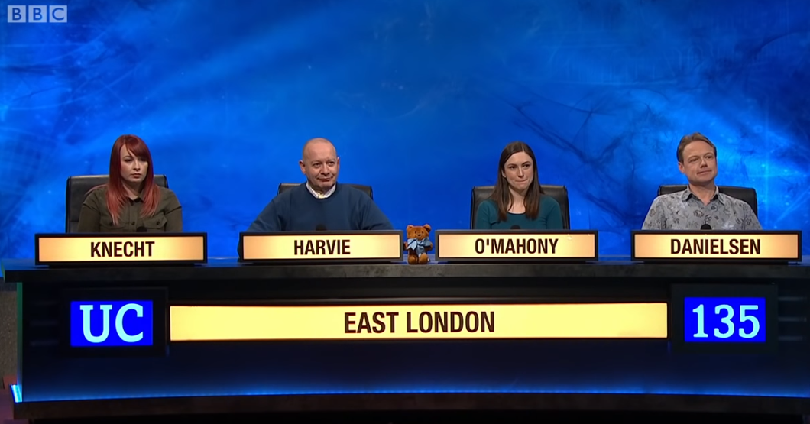
Thank you!

