Slide 1
Developing an oral pedagogy framework for teaching assistants
Dr Paula Bosanquet
Email: p.bosanquet@uel.ac.uk
Follow on twitter: @talkteam

Slide 2
Background
Numbers of TAs have risen dramatically in the past 15 years in England, now standing at around 190,000;
TAs now have significant responsibility for learning and teaching;
No consistent articulation in national policy of the pedagogical role of TAs;
Support children at risk in the education system, often replacing teachers in relation to these pupils;
Those who receive the most support from TAs consistently make less progress than similar pupils who receive less TA support, even after controlling for other possible factors;
Lack of qualitative research into the moment-by-moment interactions between TAs and children.

Slide 3
Key questions
What practices are used during moment by moment interactions between TAs and pupils?
What are the implications of these practices for the moment by moment learning experiences of pupils?

Slide 4
ITAP (Interactions of Teaching Assistants in Primary schools) design
Non-participant observation (video) of naturally occurring episodes
Episodes were TA led literacy intervention sessions
Each separate TA/pupil group constituted a case
A total of eight cases were studied, involving 4 TAs working with groups of between 3 and 6 pupils (5-6 and 7-8 years of age)
Over 13 hours of video data collected (22 recordings)
Conversation analysis was used as an analytic framework
Areas of focus in analysis were turn bidding and selection; repair practices; and management of topic.

Slide 5
Findings
Low level repair strategies (such as correction) are commonly used
Pupils are over supported and over reliant on verbal and non-verbal clueing by TAs
Opportunities for dialogic talk are routinely closed down
Interactions focus on end products rather than the learning experience

Slide 6
As a result
There is serious potential for children to become overly reliant on one to one adult support because the interactional turn taking, repair and topic development practices do not support the development of self and peer assistance strategies and dialogic interaction;
This is likely to contribute to reduced attainment over time relative to peers.

Slide 7
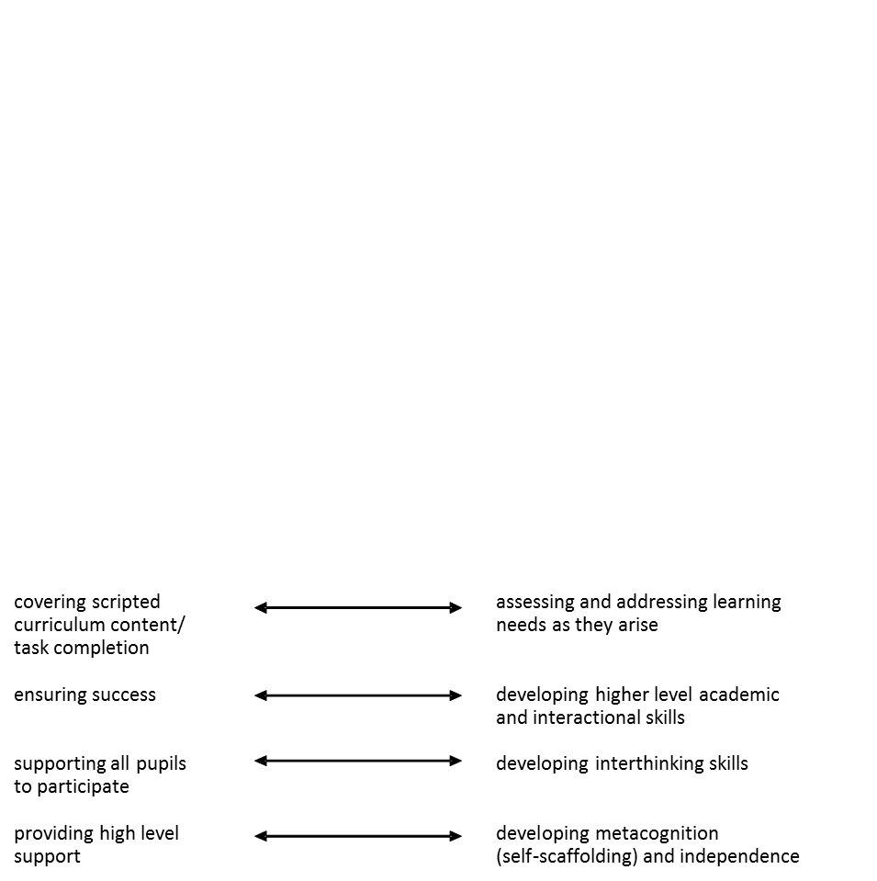
Pedagogical tensions

Slide 8
Self scaffolding
High level of pupil independence. Low level of adult support.
Prompting
Clueing
Modelling
Low level of pupil independence. High level of adult support.
Correcting

Slide 9
References
Bosanquet, P., Radford, J. and Webster, R. (forthcoming September 2015). The Teaching Assistant’s Guide to Effective Interaction: How to Maximise Your Impact. Abridge: Routledge.
Radford, J., Bosanquet, P., Blatchford, P and Webster, R., (in press) Scaffolding learning for independence: clarifying teacher and TA roles for children with SEN. Learning and Instruction.
Radford, J., Bosanquet, P., Webster, R., Blatchford, P. & Rubie-Davies, C. (2014). Fostering learner independence through heuristic scaffolding: a valuable role for teaching assistants. International Journal of Educational Research, 63, 116-126.
Bosanquet, P. (2012). Turn taking, repair and topic practices in teaching assistant led literacy intervention session. Unpublished PhD thesis: University of London.

Slide 10
Thank you!
Email: p.bosanquet@uel.ac.uk
Follow on twitter: @talkteam

