Slide 1
Can we achieve a vision of affordable high-quality childcare in Scotland for all who want it? Maggie Tierney
ICMEC seminar
7 December 2015

Slide 2
Overview
A whistle-stop tour of Scotland’s major strategies for children and their families
Childcare: a ‘crucible’ issue for families and for inclusive economic growth – the Commission’s key findings
Our main recommendations
Hard issues
Can we do it?

Slide 3
Key Scottish Policy Frameworks & Legislation
GIRFEC (Getting it Right for Every Child): the 7 SHANARRI indicators of child wellbeing
Curriculum for Excellence: children aged 3-18
Early Years Framework and EY Collaborative
National Parenting Strategy
CYP Act 2014 & Additional Support for Learning Act 2004 & Building the Ambition 2014
(Refreshed National Economic Strategy)

Slide 4
Getting it Right For Every Child

Slide 5
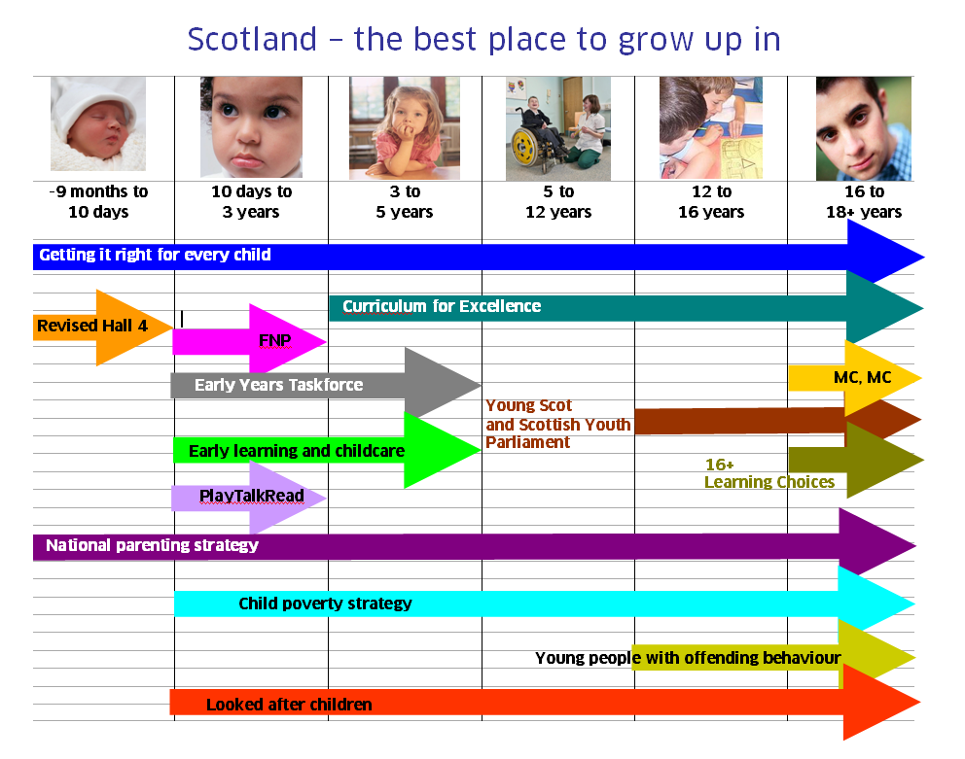

Slide 6
Childcare: a test of the efficacy of national policies for childhood
The Commission’s work, reported June 2015
What we mean by registered childcare
Our central assumptions about the care of children
4 semi-competing social outcomes sought from improved childcare provision
There is a vision for children and childhood. But there is no vision for childcare.

Slide 7
However….childcare is far from invisible in Scottish policy making
CYP Act 2014: expansion of free ELCC provision from 475 to 600 hours pa. Extension of free ELCC to 27% of 2 year olds.
First Minister’s commitment (PfG 14-15): to expand ELCC-funded provision to 30 hours pw during term time for pre-schoolers (“the 1,140 hours”)
FM’s more recent announcements (17 Oct): more graduate level staff in nurseries in disadvantaged areas, plus moving to greater flexibility for parents, including full day and summer holiday provision
Equity agenda very prominent: including the Independent Poverty Adviser’s work for FM. Forthcoming ‘Fairer Scotland’ plan, Social Justice Action Plan, Raising Attainment work etc – all of these include a child poverty/ childcare dimension

Slide 8
Some Evidence (1)
As with UK, Scotland has a mixed economy of services. Different systems in place for under 3s, pre-school, and school-age children. A range of settings.
About 1/3 of Scottish families use multiple care arrangements. Parents from low-income areas least like to use registered childcare of any kind, even when free and of high quality.
In 2015, only 15% of Scottish authorities reported enough childcare for parents who work full time (43% in England). Least availability in areas of deprivation.
Uncertain evidence on extent of current spare capacity (perhaps 20-25% underused places, but not available at times or in formats that make it easy for parents to access

Slide 9
Some Evidence (2)
What families pay varies enormously, but on average Scottish families pay more than elsewhere in the UK other than London.
Costs are highest for parents of 1-2 year olds
UK costs to parents high compared with other countries – Scotland no different.
UK (and Scotland) spend about as much as the Nordics on support to children & families, but spend it differently. Implications for anti-poverty objectives too.

Slide 10
Some Evidence (3)
Childcare market highly privatised in Scotland, as with UK. Including childminders, about 70% of all services for 0-5s.
Prices not regulated or capped
Different services poorly integrated, introducing significant logistical problems for families with more than one child
Instability/ unevenness in the supply of services (including rural dimensions for Scotland)
Agreement that public supply-side subsidy levels are too low; that small private providers depend heavily on public ELCC investment to remain viable; and that options ofr low income families are too narrow. More investment needed
The way public funding is distributed is at least as important as its total amount. As a devolved administration, this is a particularly important feature for Scottish funding of childcare

Slide 11
Our Key Findings
Many parents are able to access and afford high quality provision that meets their needs (just about!)
Real commitment from Scottish and UK Governments to invest in childcare
But too many parents cannot access, or cannot afford, childcare that meets their needs
Funding of childcare, for families and providers, is complex, confusing, unfair and lacks transparency
There is no agreed national strategy

Slide 12
Main Recommendations
Develop a long term vision and a strategy to deliver that vision. Stop dealing with individual issues in isolation.
Establish an entitlement to access 50 hours per week of affordable flexible childcare
Make local arrangements to secure delivery of that entitlement
Limit the amount contributed towards that 50 hours to 10% of household income: less for poorer families
Simplify funding mechanisms so families can easily understand and access their entitlement and providers receive simple, fair, transparent funding from the state

Slide 13
Genuinely Difficult Issues
Simplifying the tax and benefits systems, and how they complement free provision, to make the funding of childcare seem simpler and more rational to families
Operating a mixture of free, subsidised and fully paid for provision, based on local decision making, in a way that enables a healthy market and delivers on the child’s entitlements to a high-quality experience
Managing expansion to protect and promote the quality of provision, and to control costs to the state
Balancing the needs of employers, parents, childcare providers and staff working in the sector without sacrificing the needs of the child.
Deciding how best to provide financial support to families with very young children

Slide 14
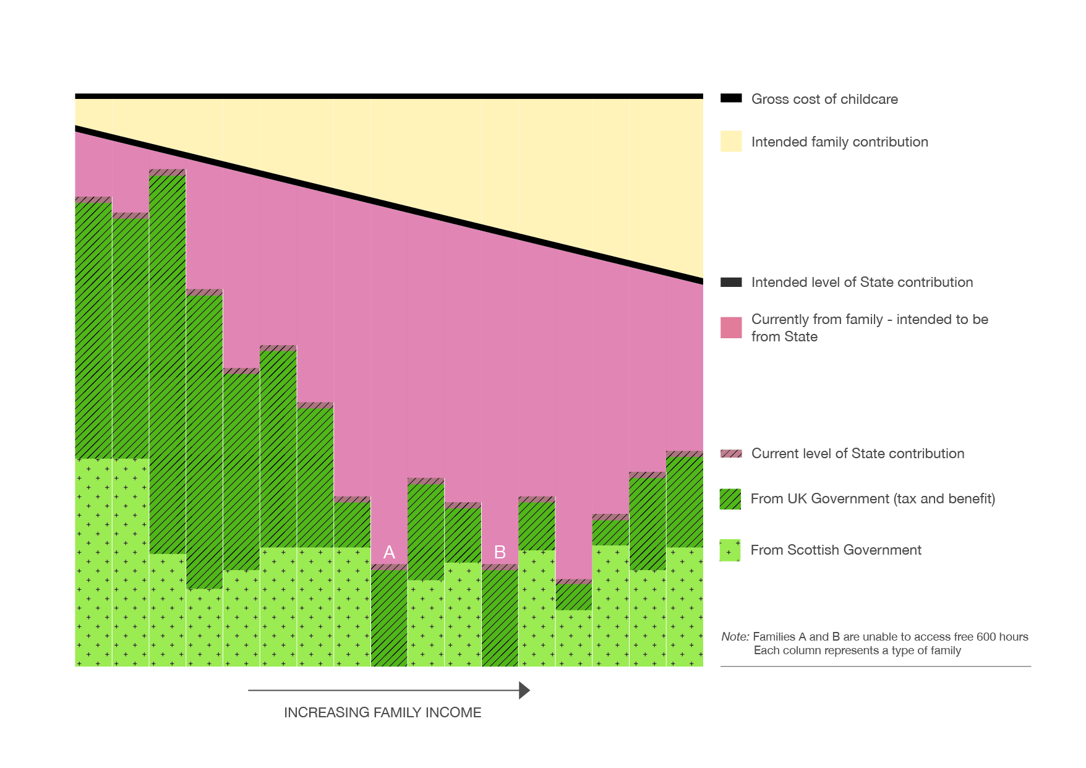

Slide 15
Issues that should not be hard – but will be
Scottish and UK Governments working together on funding issues
Rebuilding trust between providers and funders
Policy makers and local authority managers taking a holistic view of the needs of families (for available affordable childcare, as well as for early education) – rather than dealing with elements in isolation
Accepting the existence of real problems and fixing them, rather than finding justifications for existing actions that create problems for families

Slide 16
Can we achieve the vision in ways that are affordable for parents and the state alike?
What models already exist that look promising? (hubs, blended domestic and group care, partnerships, flexible schools, social enterprise)
Can we route available monies (public investment as well as parents’ contributions) in more effective ways?

Slide 17
A Possible Free + Subsidised Model
Free preschool provision 6 hours/day
Capped provision to max 20 hours/week
Non-capped but regulated provision

Slide 18
1
Potential basics of a Child Account Scheme
Government: Free preschool education; Tax Free Childcare; Childcare Tax Credit/childcare element of UC; Childcare Grant
Parents & Wider families and friends: Contributions
Employer: Potential employee work benefits
Third sector: Charities etc.
Child Account
Others: Future policy initiatives (unknown today)
Registered ELCC providers
Preschool education
Childcare
Out of School care
Registered in-home care
Childminders
…

Slide 19
Can we achieve our vision?
How can we use local pathfinders to establish successful examples of genuinely more powerful local planning and decision-making?
Does greater flexibility for parents potentially damage child development outcomes? What can we do to balance flexible services with high-quality provision?
Will governments’ current focus on inputs like more free hours (UKG as well as SG) further cement the difficulties of the current childcare market?
A possible Charter for Childcare

