Slide 1
Supporting private childcare providers’ sustainability
Ivana La Valle ICMEC Visiting Scholar
ICMEC seminar 03.03.14

Slide 2
Presentation overview
Developments in the early education and childcare (EEC) landscape in England since the late 1990s:
Policy developments
Parents – trends in take-up and barriers
EEC providers – trends in provision and challenges

Slide 3
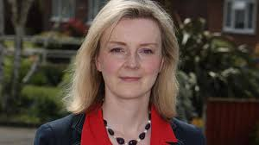
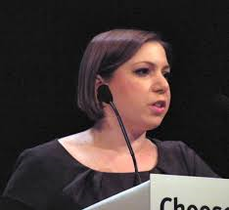
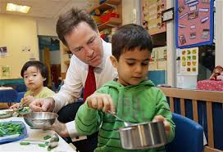
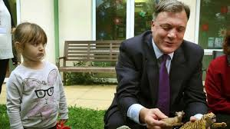
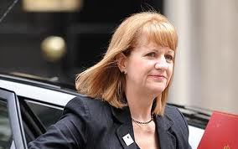
Policy developments

Slide 4
Different (and competing) policy agendas
Focus on children – children’s s rights/development (DfE)
Focus on parents (mothers) –reduction in welfare bill, child poverty/social mobility and gender equality (DWP and women’s minister)

Slide 5
Long list of policy developments
Meeting the Childcare Challenge (1998
Free entitlement for 4 year olds (1998)
Childcare element of the WTC (1998)
Sure Start Local Programmes (1999)
Care Standards Act (2000)
Neighbourhood Nurseries (2001)
10-Year Strategy for Childcare (2004)
Extended schools (2004)
Free entitlement for 3 year olds (2004)
Childcare Act (2006)
Early Years Professional status (2006)
Childcare vouchers (2006)
Early Years Foundation Stage curriculum (2008)
Early Years Single Funding Formula (2009)
A children centre in every neighbourhood (2010)
Statutory Framework for the Early Years Foundation Stage (2012)
Free entitlement for disadvantaged 2 year olds (1998, 2013,2014)
Childminder agencies (2013)

Slide 6
Key aims of EEC policy since late 1990s
Universal PT provision for 3&4 year olds and targeted PT provision for 2 year olds – free at the point of delivery
Quality improvements – curriculum, registration & inspecton, workforce qualifications and ‘feeble’ attempts to link to funding
More flexible provision – market forces and attempts to link to funding
More affordable provision – subsidies, reduction in child: staff ratios, less regulation
Improvement in information available to parentes on EEC options

Slide 7
EEC growth within a mixed economy model
EEC provided by a quasi-market reflected in diversity in terms of:
Who provides EEC: PVI and maintained sectors
Who funds EEC: the state and parents (employers)
How funding is allocated: supply and demand side subsidies
Who uses EEC: unintended consequence?

Slide 8
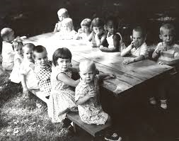
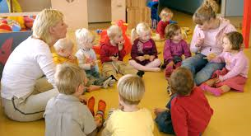
How patterns of EEC take-up have changed and what are the barriers to take-up

Slide 9
Increase in EEC take-up between 1999-2012
0-2 yr olds:
25% to 37%
3-4 yr olds:
65% to 88%
Overall: 21% to 53%
5-7 yr olds:
16% to 56%
8-11 yr olds:
12% to 53%

Slide 10
Main determinants of take-up of EEC
In 1999:
Age: pre-school children and particularly 3-4 year olds
Income: children from higher income families
In 2012:
Age: 3-4 year olds
Income: children from higher income families

Slide 11
Income gap
Take-up of EEC:
In 1999: 19% of families in lowest v. 42% in highest income group (23 pp)
In 2008: 31% of families in lowest v. 58% in highest income group (27 pp)
In 2012: 41% of families in lowest v. and 68% in highest income group (27 pp)

Slide 12
Reported barriers to EEC access
Costs and complex demand-side funding system
Variability in provision – when and where EEC provided
Lack of flexibility – ‘fixed’ offer or expensive flexibility
Lack of places for disabled children/children with SEN
Inadequate information about EEC
Lack of access to family-friendly working arrangements particularly among disadvantaged mothers

Slide 13
Changes in parents’ views and experiences 2004-12
% who reported:
Enough places in local area: from 40% to 42%
Quality of childcare in the area is good: from 61% to 58%
Affordability of childcare in the local area is poor: from 37% to 39%

Slide 14
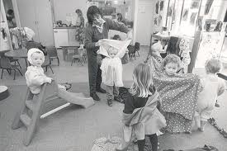
Trends in supply of EEC –places and qualification levels, and challenges

Slide 15
Nursery schools/classes in maintained sector
802,000 places – little change 2006-11
In 2012: 57% of 3&4 yro
Day nurseries
750,300 places – 29% growth 2006-11 Sector: P 68%, V 22%, M 10%
In 2012: 19% of 0-2 yro & 17% of 3-4 yro
Sessional care
251,000 places
10% decline 2006-11
Sector: P 37%, V 57%, M 6%
In 2012: 6% of 2 & 14% of 3-4
Childminders
236,900 places
13% decline 2006-11
In 2012: 3-6% of 0-11 yro
After school clubs
357,400 places
37% increase 2006-11
Sector: P 42%, V 24%, M 34%
In 2012: 36%-47% of 5-14 yro
Holiday clubs
339,300 places
29% increase 2006-11
Sector: P 50%, V 25%, M 25%
In 2012: 8% of 5-14 yro

Slide 16
Nursery schools/classes in maintained sector
7-10% Level 4-5 (v. 5-7% in 2007)
31-35% Level 6+ (v. 29% in 2007)
Day nurseries
16% Level 4-5 (v. 7% in 2007)
11% Level 6+ (v. 4% in 2007)
Sessional care
11% Level 4-5 (v. 4% in 2007)
8% Level 6+ (v. 4% in 2007)
Childminders
6% Level 4-5 (v. 1% in 2007)
4% Level 6+ (v 3% in 2007)
After school clubs
11% Level 4-5 (v. 5% in 2007)
8% Level 6+ (v. 4% in 2007)
Holiday clubs
13% Level 4-5 (v. 6 % in 2007)
9% Level 6+ (no change)

Slide 17
Group providers’ annual income 2010-12

Slide 18
Childminders’ annual income 2010-12

Slide 19
EEC providers financial viability - 2011

Slide 20
Providers operating at a loss in 2007 & 2011

Slide 21
Level of occupancy in 2011

Slide 22
Changes in fees 2010-12

Slide 23
The EEC market: tinkering or transforming?
Parents can’t access EEC and providers with unfilled places
Parents can’t afford EEC and providers who make a loss
Qualifications well below level associated with high quality
Can’t increase parental fees and/or staff:child ratios to fund increase in qualification levels?
Disadvantaged areas and families better catered than in the past, but mainly by the maintained sector
2 yro entitlement test of whether other parts of the market can deliver both in terms of quantity and quality

Slide 24
About this presentation
This presentation was delivered at a seminar organised by ICMEC, the International Centre for the Study of the Mixed Economy of Childcare, based in the Cass School of Education and Communities at the University of East London, UK, on 3 March 2014.
In 2013/14 Ivana LaValle is attached to ICMEC as a Visiting Scholar.
ICMEC’s website address is: http://www.uel.ac.uk/icmec/
The latest Department for Education childcare and early years providers survey can be found here: http://tinyurl.com/p76xel3

