Slide 1
The practicalities of childcare
Kayley Hignell & Sarah Pope
Citizens Advice

Slide 2
Who we are
Who we are
Our aims
To provide the advice people need for the problems they face.
To improve policies and practices that affect people’s lives.
Our principles
The Citizens Advice service provides free, independent and impartial advice to everyone on their rights and responsibilities. We value diversity, promote equality and challenge discrimination.
The Citizens Advice service helps people to resolve their problems.
In 2013/14 we helped 2 million people in England and Wales with 5.5 million problems.

Slide 3
Our services
2013/14
318 member bureaux in England and Wales (F2F phone, web-chat, email/letter)
2,500+ regular community locations
1,000+ ad-hoc locations
Consumer advice service (phone, email/letter) in England, Wales and Scotland
Our website ‘Adviceguide’ providing extensive self-help information on a wide range of topics.

Slide 4
The problems we dealt with in Q2 2014-15
Bureau and Consumer Services
Adviceguide page views by category in Q2 2014/15

Slide 5
Why look at the practicalities of childcare?

Slide 6
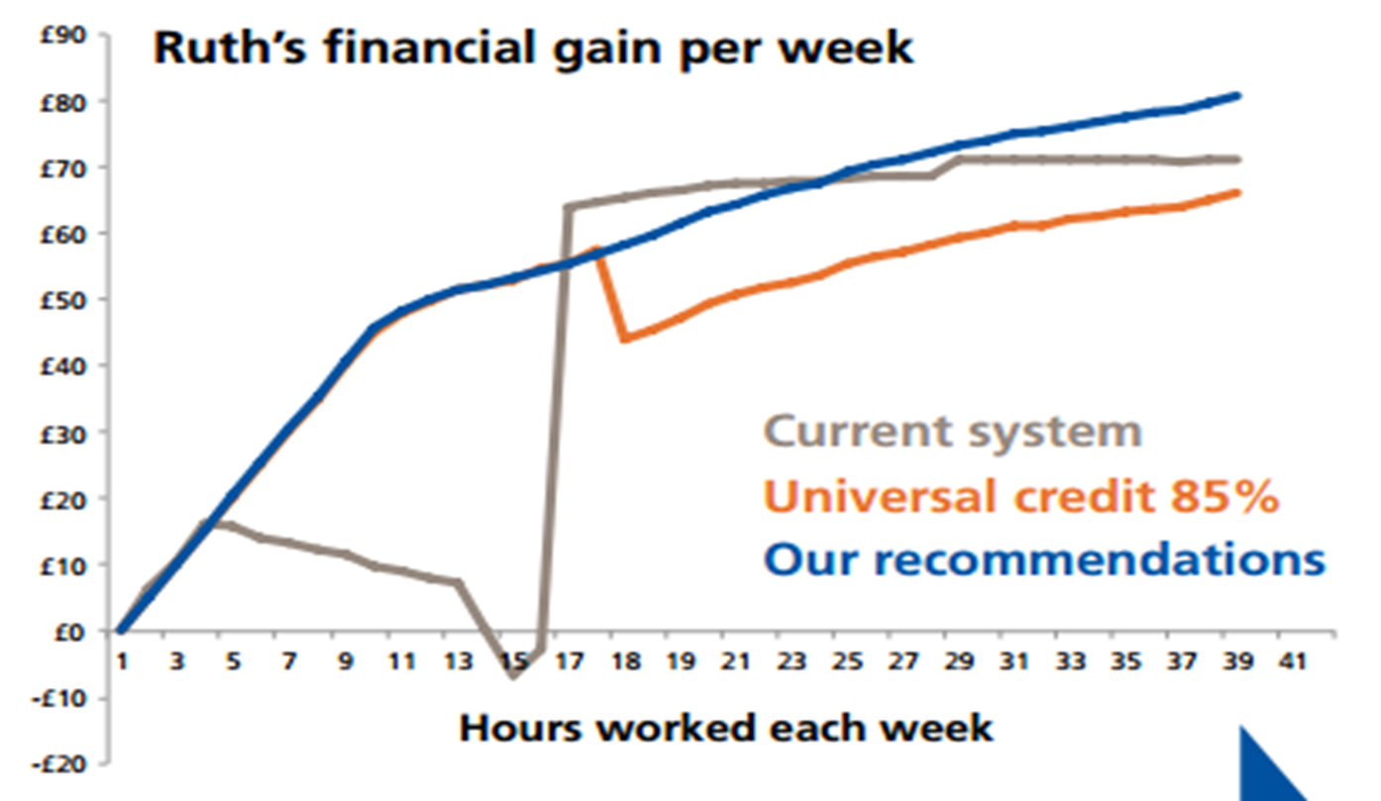
Why look at the practicalities of childcare?

Slide 7
What we did
Mystery shopped 400 different childcare providers across England
 | Childminder | Early Years | Day Nursery | Out of School
Our % | 44% | 16% | 23% | 18%
National % | 53% | 8% | 19% | 20%
Ofsted Grade | 1 | 2 | 3 | 4
Our % | 17% | 68% | 14% | 1%
National % | 12% | 66% | 21% | 2%

Slide 8
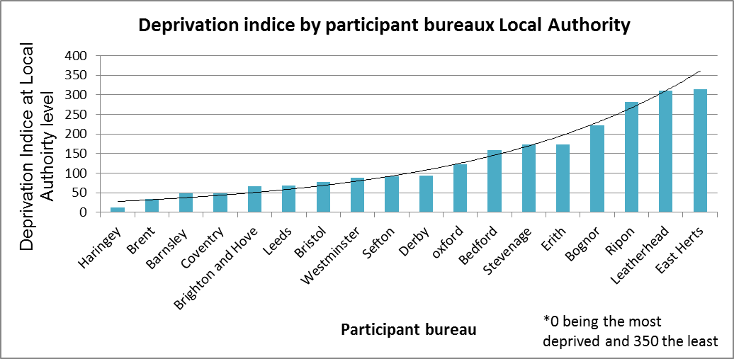
What we did?

Slide 9
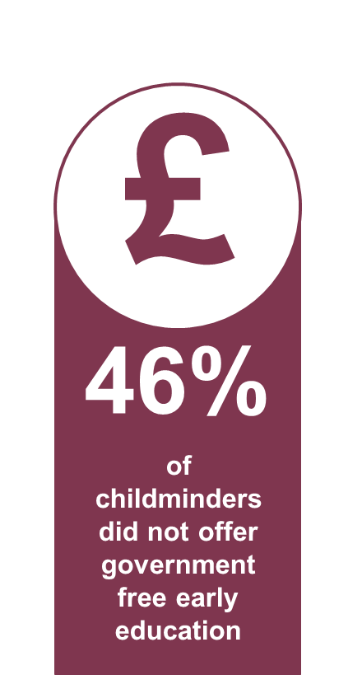
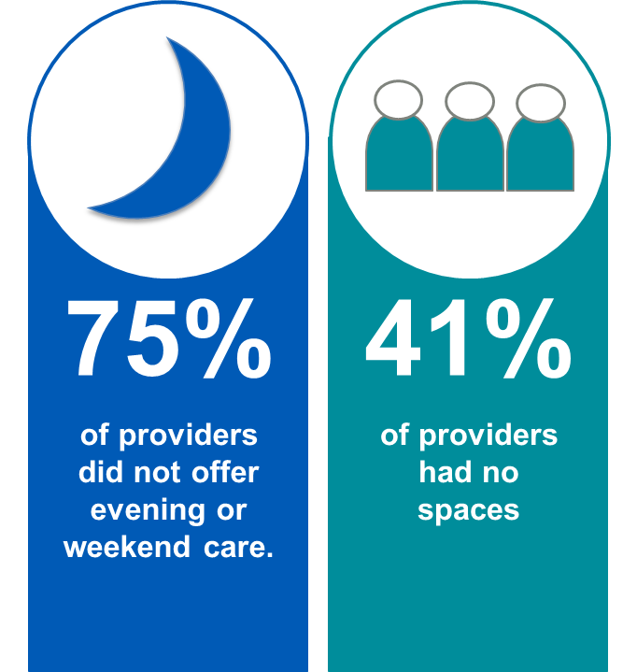
Findings: Availability
Notes:
Availability
three quarters of providers did not have evenings and weekends
Over a third didn’t have a place
Nearly half of childminders didn’t offer 15 hours
100% of day nurseries and EYE
Over a third didn’t have a place

Slide 10
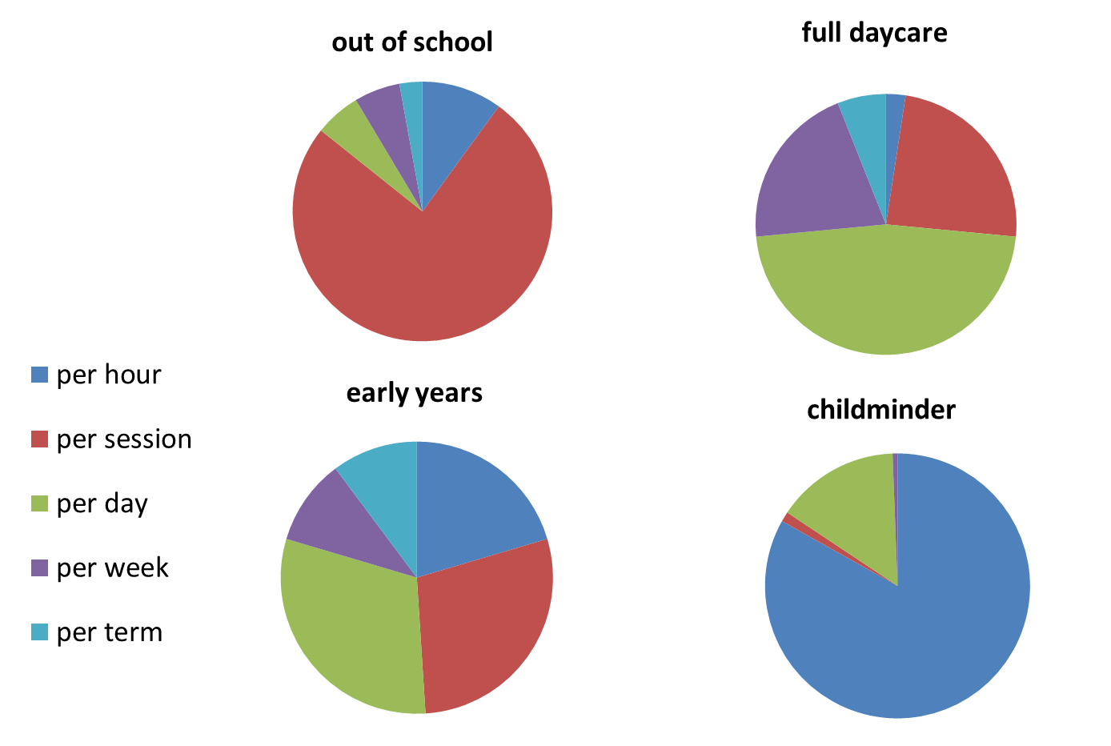
Findings: Payment

Slide 11
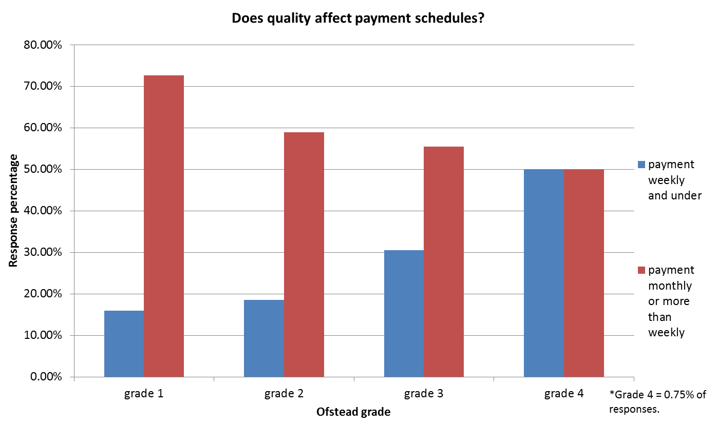
Findings: Payment

Slide 12
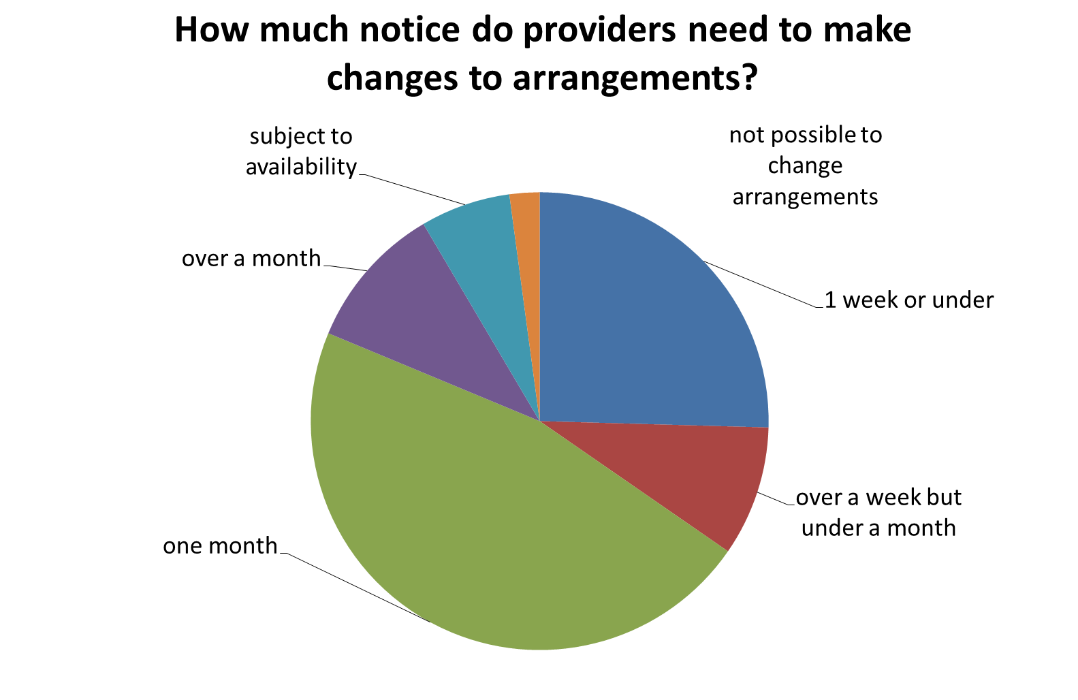
Findings: Flexibility

Slide 13
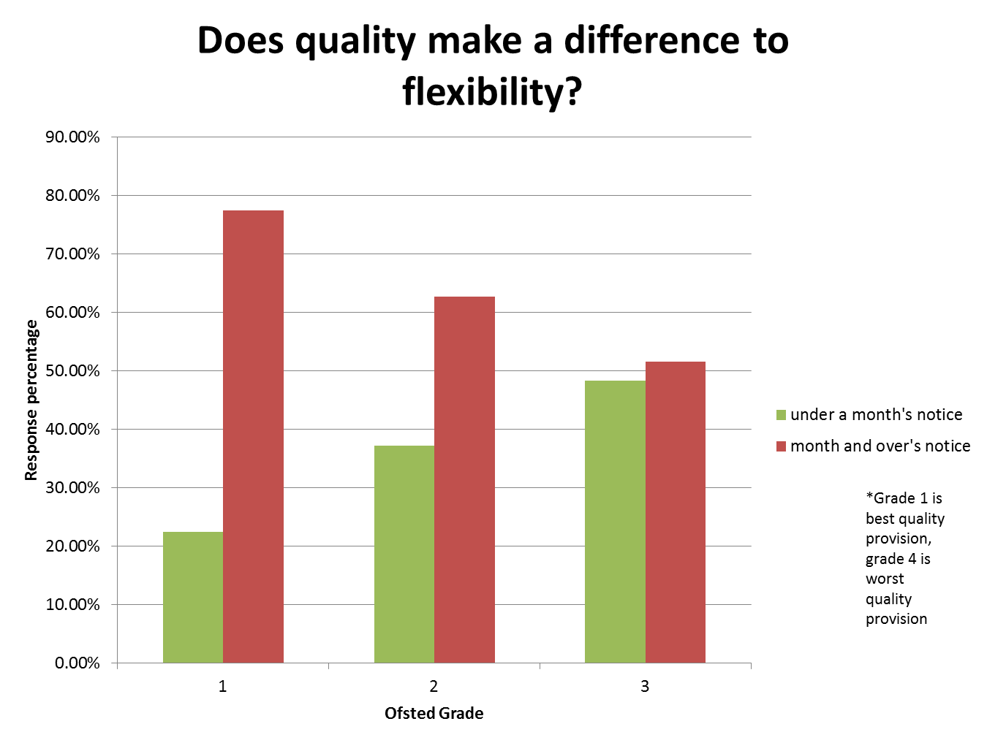
Findings: Flexibility

Slide 14
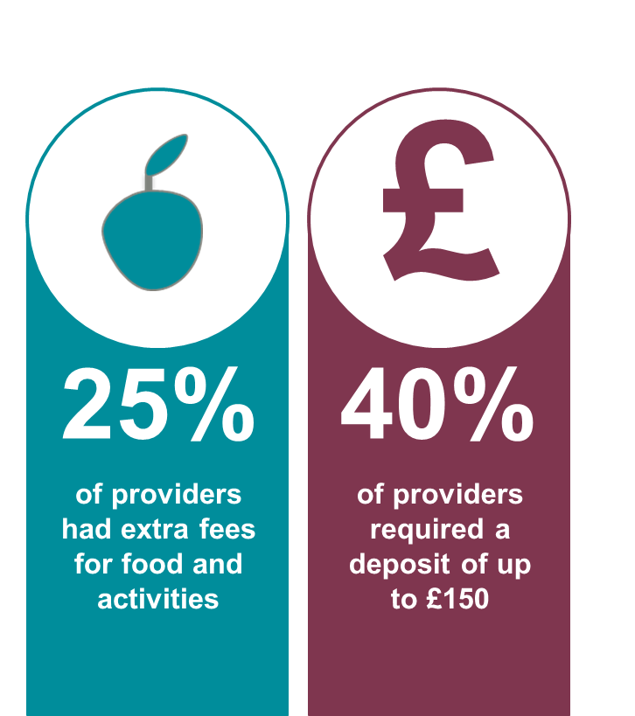
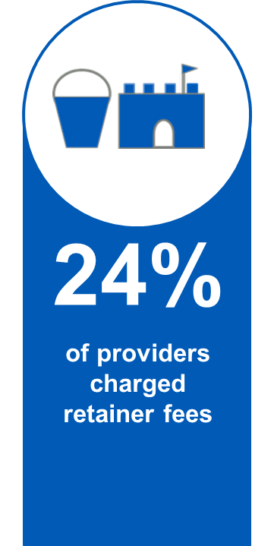
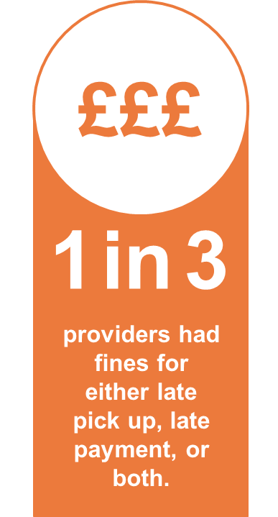
Findings: Upfront and extra costs

Slide 15
Moving beyond funding and places
Wider debate about childcare; not just about allowing employment or improving education but enabling children and families to thrive.
Whole family approach is needed. So many factors impact on whether families are able to find an arrangement that works for them practically, but current policy often assumes that it’s just about supply and subsidy.
Number of children
Types of hours worked by parent(s)
Distance of places of work/study from home
Availability of informal care
Personal child-rearing values of the parents
Health of all family members

Slide 16
Meeting the needs of working parents
Employers need to be doing more for both parents;
Being open to job-sharing is the tip of the iceberg; need to move away from part time and full time to flexitime
The secondary care giver working long hours just further constrains the ability of the primary caregiver to advance their studies or careers
The free 15 hours needs to change to enable parents to work
Increasing free hours is ideal for low-income parents, but must be fully funded, alternatively
More could be done to provide pay as you go wrap around provision at pre-schools at a reasonable cost
Studying parents need on-campus subsidised care; a cheap way of enabling workforce to upskill!

Slide 17
Targetting those with non-standard needs?
Free/very cheap at the point of delivery works best or low income parents
Attachment to schools reduces the practical barriers to work where there is more than one child
Policy needs to be about enabling the right number of hours at the right time, not the most hours at particular points.
Taking up job opportunities often relies on very flexible providers/pay as you go provision
More needs to be done to increase the supply of non-standard hours care, and it should cost the same per hour as regular care.

Slide 18
Recommendations
Benefits: the way childcare support is delivered through universal credit.
The assessment and delivery of sufficient childcare by local authorities.
The business support role of local authorities and relationship with local Jobcentres
Work seeking support for parents

Slide 19
Emotional burden
Lots of negative emotions associated with the process of finding and retaining childcare
Single parents feel the burden keenly, but often those in couples also reported that the onus fell on the woman
Having to compromise leaving parents feeling constantly guilty
Relying on family support requires further affective labour

