Slide 1
SPN East of England Event 2017
Evaluating social prescribing and the importance of sharing information
Caroline Frostick (Research Fellow)
Dr. Marcello Bertotti (Senior Research Fellow)
Institute for Health and Human Development
University of East London
Notes:
No one size fits all
Importance of thinking through evaluation from start.
A bad evaluation is worse than no evaluation!

Slide 2
THE SOCIAL PRESCRIBING PATHWAY
Patients
Clients
Social prescribing empowers individuals to improve their health, wellbeing and social welfare by connecting them to non-medical and community support services. (NSPN)
GP practices
Other referral sources
Link workers
Face to face or telephone
Community and statutory organisations
Notes:
Terminology
Patients / clients
Link Workers / Social Prescribers

Slide 3
Social prescribing logic model
e.g. link workers; funding.
INPUTS
e.g. face to face sessions between link worker and user.
ACTIVITIES
e.g. number of users referred by GP practices.
e.g. improved satisfaction.
OUTPUTS
OUTCOMES
Methods
Measurement tools

Slide 4
Why bother to evaluate social prescribing?
Evaluations can be costly and time consuming - so why would you build one into your project?
To find out what kind of effect your intervention is having on your clients (hopefully positive!)
This enables you to then:
Provide evidence of effectiveness to funding bodies in order to attract or retain funding for the project.
And ultimately:
As evidence of effectiveness builds up this will help to convince others, particularly policy makers, to develop/fund similar interventions in the future.

Slide 5
Understanding your population
Who are the people you are trying to help? Gender, age, needs and aspirations?
What would represent a good outcome for them?
What tools/methods might best capture any change in their wellbeing?
Are they likely to find it distressing to be interviewed or asked to answer lots of questions? Other ethical considerations?
Do they speak and understand English - do you have the resources to translate if not?

Slide 6
Quantitative or qualitative?
Quantitative
Policy makers and funding bodies want statistics to show significant effects at the population level.
But can be a blunt instrument and it is important to use the right tools. Data collection and analysis can also be costly and take a long time to complete.
Qualitative
Interviews with patients can be very impactful and capture a real sense of the change that has taken place for an individual.
But carry less weight as evidence because findings cannot be applied to the population as a whole.
Ideally both!

Slide 7
Evaluation methods
In an ideal world…
RCT – recognised as the ‘gold standard’ by funders and policy makers.
However RCTs are:
Expensive
Difficult to apply to complex interventions (they were designed to test drugs).
Ethically challenging – although this can be overcome eg. Stepped Wedge design. Alternatively you could use a before/after comparison with matched control group.
Economic evaluation – eg. SROI
Another straightforward and impactful measure of change could be showing improvements (before and after) in GP or A&E attendance. Self-report data can be misleading – this data is best collected through EMIS.
Notes:
Explain Stepped Wedge
Partial evaluation: eg. SROI, no control needed, not as rigorous & not accepted by NICE. Richard work: £1-£3 return.
Full economic evaluation: eg. cost-benefit analysis, full economic evaluation not yet done on SP.

Slide 8
Tools commonly used to evaluate social prescribing
Outcomes | Measurement tools used
Mental health/Wellbeing | HADS WEMWBS Sense of coherence scale Rosenberg self esteem scale PHQ9; BDI; GAD-7; Hope scale
Quality of life | EQ-5D-5L SF-12/SF-36 MYCAW
Healthcare resource use | SROI cost benefit
Activation | Patient activation measure
Social capital/social isolation | Social networks/social support
Notes:
SF stands for Short Form
MYCAW

Slide 9
These tools have been used in many social prescribing evaluations. Some are free to download online, others you will need to pay for.
Advantages:
The advantage of using well-validated tools is that results can be compared to other studies.
Disadvantages:
They can be a bit of a blunt instrument and it is important to think carefully about what they are designed to measure and how patients and clients are likely to interpret the questions in relation to their experiences of social prescribing.
A common frustration of evaluating social prescribing interventions is that clients may clearly describe ‘life-changing’ experiences in an interview but no change is found in between measures of baseline and follow-up.

Slide 10
Alternative methods of evaluation
Social prescribing tends to be a complex intervention with several moving parts. RCTs don’t take into account the environment in which the intervention is delivered or the people and processes involved. You could include a process evaluation to address this.
Alternatively a Realist Evaluation allows you to break down the intervention into its component parts by examining:
CONTEXT-MECHANISM-OUTCOMES
(Pawson & Tilley,1997)
Notes:
Not just ‘what worked’ but ‘how it worked’.

Slide 11
Other useful information to collect
Socio-economic:
Demonstrating changes in socio-economic conditions, rather than just health outcomes. Eg. experience of activities/support in the community:
How many sessions has the patient had with the social prescriber?
What activities/support has the patient engaged with as a result of SP?
How many sessions did they attend and over what time period?
What other support/activities was the patient already involved with?
Demographics:
Don’t forget to collect demographics eg. age, gender, ethnicity. This allows you to look for effects in one group that may not be present in the sample overall.
Level of education, employment status and living arrangements (are also useful!)

Slide 12
Summary of things to consider
The primary purpose of evaluation (eg. What information is meaningful for funder?)
Time and resources available to carry out evaluation. Who is going to collect the information, who will analyse it – do they need to be independent of the organisation?
Relevance and accessibility and of tools – are they straightforward to fill in? Do they measure what they need to measure? Impact on patients/social prescribers/GPs. Do they have time to fill in forms or conduct interviews?
The Social Prescriber is (a very!) important part of intervention. Baseline data collection should occur before the first interaction.
Importance of piloting. Are there any ethical considerations?
Work closely and flexibly with those delivering the service!
Notes:
Consider collecting data at different points in time.

Slide 13
An SP project you are evaluating or would like to evaluate…
What is the main purpose of your evaluation? (eg. retain funding)
What are the characteristics/needs of the population you are working with?
What would represent a good outcome for them?
What resources to you have to carry out an evaluation?
What methods and tools would be most likely to capture any change in your patients?

Slide 14
Social Prescribing in City and Hackney: lessons from implementation and evaluation
Dr Marcello Bertotti,
Caroline Frostick
University of East London
Dr Patrick Hutt
Clinical Lead, City&Hackney CCG

Slide 15
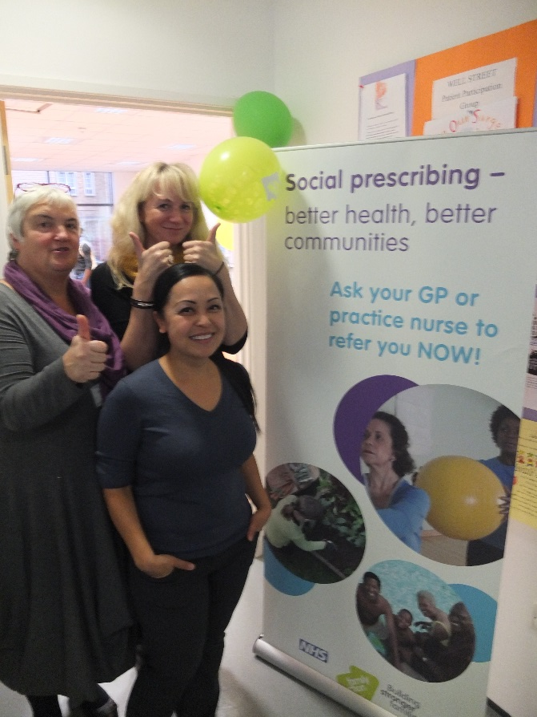
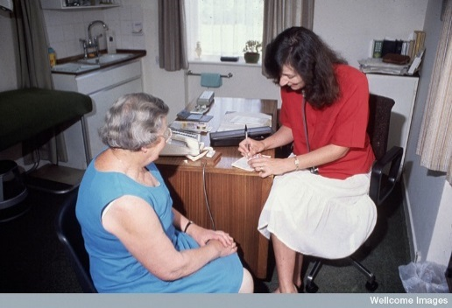
Social Prescribing City and Hackney CCG
New Age Games
Social Prescribing team facilitating better linking between GPs, patients and community organisations

Slide 16
Evaluation
Independent Evaluation (UEL and Queen Mary)
Qualitative interviews with 20 participants
Quantitative (baseline and 8 months follow up)
Control Group – patients matched
Economic evaluation
Process evaluation – learning events, interviews with Wellbeing coordinators, community organisations, GPs
GP online survey

Slide 17
Referral Criteria
Socially isolated
Frequent attenders to GP/A+E
Presenting with a social problem
Mild-moderate mental health problems
Notes:
Avoid becoming a dumping ground!

Slide 18
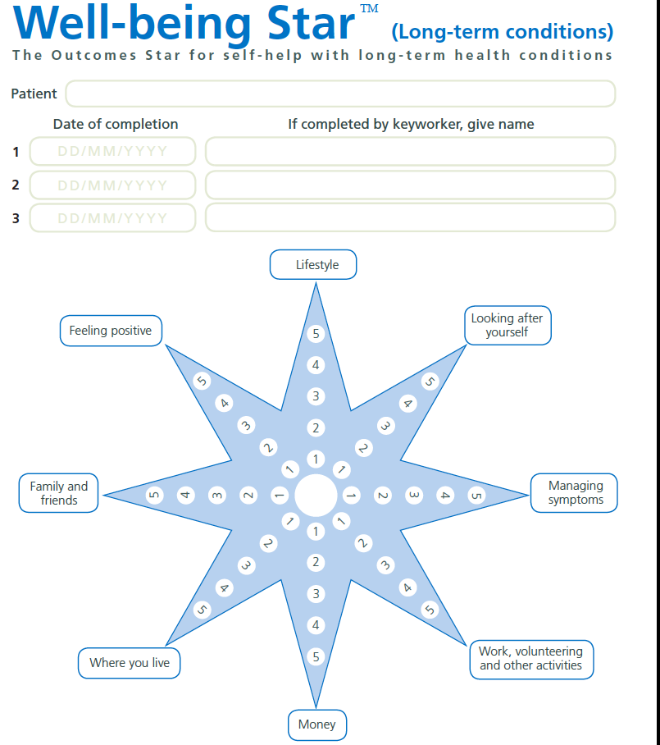
So what happens when you refer?
Lifestyle
Looking after yourself
Feeling Positive
Family and Friends
Managing symptoms
Where you live
Work, volunteering
Money
Notes:
WELL BEING
11% DNA RATE, 34% 1 CONSULT, 11% MORE THAN FIVE

Slide 19
A wide range of options!
Notes:
Know what is out there – can you actually help people?! Eg Housing issues.

Slide 20
Baseline data from intervention and control
We looked at changes in wellbeing, health, anxiety, depression, and social engagement using validated tools including HADS (Hospital Anxiety and Depression Scale), MYMOP (Measure Yourself Medical Outcome Profile), HeIQ (Health Education Impact Questionnaire)

Slide 21
Prospective cohort study with matched control
184 SP users from 22 GP practices
Baseline
Matched 302 patients from 6 GP practices
8 months Follow up
CHARACTERISTICS OF THE SAMPLE
Age
Gender
Ethnicity
SP users were:
Living alone more
More in non-paid work, fewer employed
Less educated

Slide 22
Results from qualitative study
Changes in self-esteem, hope, motivation particularly when sustained through volunteering
“Best thing has been meeting new people and making friends. My mobile full up with names and numbers of friends before it was just family and doctor’s number. I was really depressed before but now really happy. Before I have nothing to do, now every day I wake I think ‘yes volunteer work!’ or ‘meeting friends!’”
Role of social prescriber key to positive changes:
“You feel able to offload if you need to, discuss your fears - it’s about not being so hard on myself and validating myself.”

Slide 23
Results and conclusions of cohort study
No statistically significant changes in anxiety, depression, health, wellbeing and integration over 8 months
BUT statistically significant reductions in GP consultation rates in comparison to control (one year pre and post referral). However, could be due to ‘regression to the mean’.
A clear gap between qualitative and quantitative evidence
Further quantitative research is needed with larger samples (only 11% of people at follow up responded), different design and other tools to assess health changes

Slide 24
Key issues
Low number of referrals from GP practices
“The terrible thing is that I referred five but I should have referred about 15 times that. Although I am very enthusiastic about it, it is hard to keep in front of your mind, and that’s the challenge!” (General Practitioner)

Slide 25
Issues that can impact on evaluations
Branding: Patients did not recognise the term ‘social prescribing’ this could have had implications, particularly for quantitative elements of the data collection.
Feedback: GPs were not hearing about ‘success stories’ in their patients from the intervention further down the chain and this may have influenced referral numbers.
Data collection: Community organisations did not have the resources or structures in place to collect data on referrals. It was sometimes difficult to know who had come through the pathway and how many sessions they had attended.
Resources: Community organisations would disappear due to lack of funding. Apart from the problems this caused patients, the social prescribers found it difficult and time-consuming to keep on top of the support available.
Inappropriate referrals: social prescribing service used as a ‘dumping ground’ for problem patients from other organisations. Need to specify patient criteria and who the service can realistically help. This can be particularly damaging to an evaluation.

Slide 26
The importance of sharing information
The evaluation of social prescribing is still in its infancy.
Enable new projects and evaluations to learn from to learn from the experience of others. By sharing challenges and what went wrong.
Development of interactive, online repository for all things social prescribing.

Slide 27
THANK YOU FOR LISTENING
c.frostick@uel.ac.uk
Research Fellow
Institute for Health and Human Development
University of East London
Stratford

