Slide 1
Social Prescribing in City and Hackney: challenges from implementation and evaluation
Dr Marcello Bertotti
Senior Research Fellow
Institute for Health and Human Development
University of East London
Bristol – 20th Oct 2016
Notes:
City and hackney CCG (Patrick Hutt)
Health Foundation
Queen Mary university

Slide 2
Overview
Brief description of Social Prescribing in City and Hackney
Results from qualitative evaluation and video
Challenges from implementation
Challenges from the evaluation of health outcomes
Conclusions

Slide 3
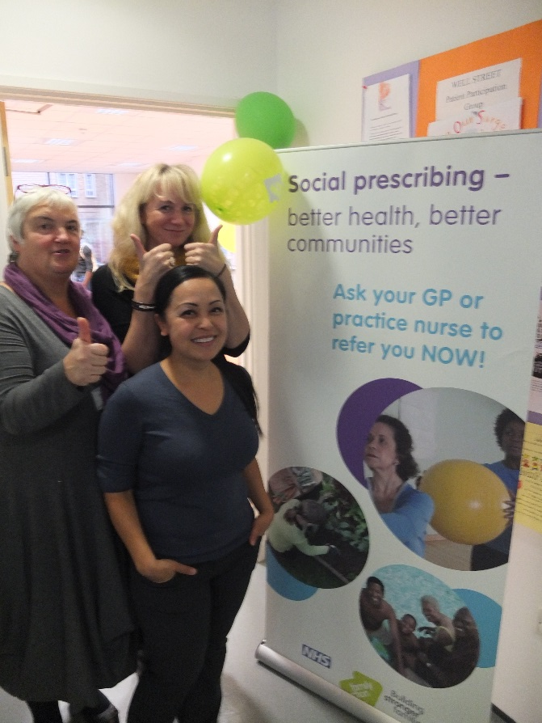
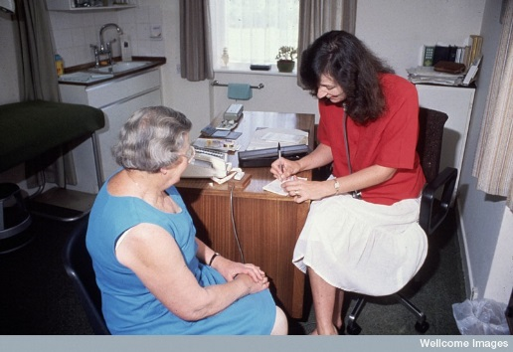
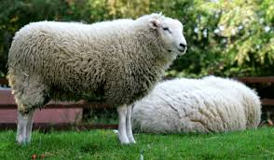
Social Prescribing City and Hackney CCG
737 patients
New Age Games
22 GP practices
3 social prescribers
85 organisations
Social Prescribing team facilitating better linking between GPs, patients and community organisations
Notes:
Had dedicated and trained SP coordinators which supported 737 participants (Feb 2014 - July 2015) for up to eight, one hour long, sessions to co-produce a well-being plan;

Slide 4
Referral Criteria
Socially isolated
Frequent attenders to GP/A+E
Presenting with a social problem
Mild-moderate mental health problems
Keen to participate in non-clinical activities but not aware of what’s happening locally

Slide 5
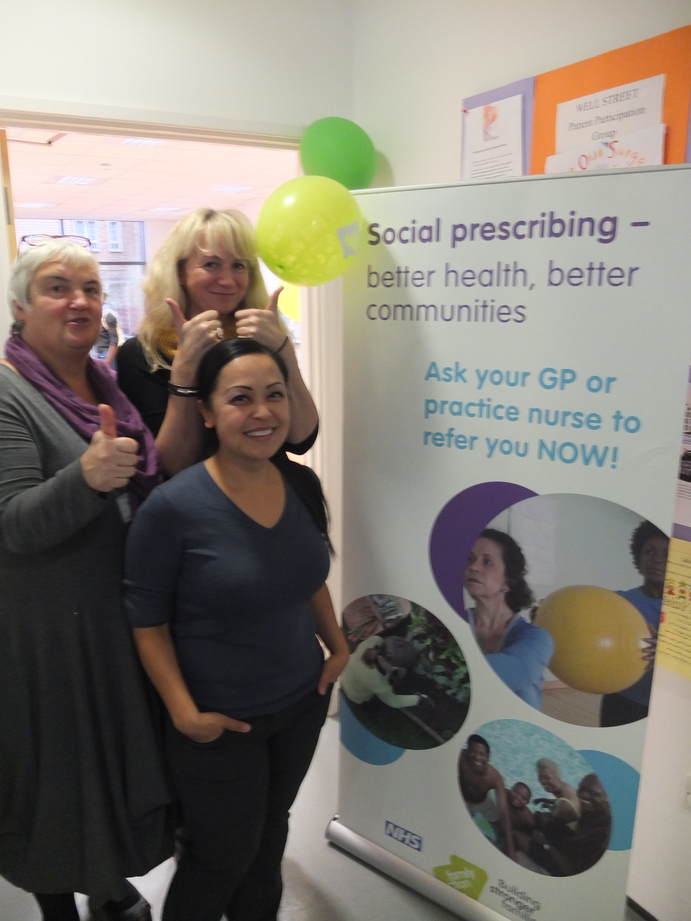
So what happens when you refer?
Role of Link workers
Signposting
Coaching
Knowledge about community activities
Modes of delivery
Face to face (up to 6 sessions)
Notes:
Co-produced with users

Slide 6
Notes:
11% DNAs

Slide 7
A wide range of options!
Notes:
TAYLOR MADE – USTILISING PUBLIC HEALTH HERO
85 REFERRAL CENTRES

Slide 8
Evaluation
Qualitative
Process evaluation (focus groups with stakeholders)
Quantitative
Two Learning events
Two online GP surveys
Notes:
The evaluation took place between Feb 2014 and July 2015

Slide 9
Qualitative study
In-depth interviews with 15 participants to capture their experience of the intervention
Some of participants chosen randomly
Representative in terms of ethnicity, gender, age
Complex co-morbidities (often mental health with physical health and isolation)

Slide 10
Results from qualitative study
Changes in self-esteem, hope, motivation particularly when sustained through volunteering
Role of social prescriber key to positive changes (from signposting to coaching)

Slide 11
Video
https://youtu.be/PCxRLAM7wBQ

Slide 12
CHALLENGES in developing social prescribing in City and Hackney

Slide 13
Number of referrals from GP practices
“The terrible thing is that I referred five but I should have referred about 15 times that. Although I am very enthusiastic about it, it is hard to keep in front of your mind, and that’s the challenge!” (General Practitioner)
Potential solutions
Feeding back good news to GPs
Make social prescribers part of the practice team – meetings etc
Contractual target for GPs as part of the Long Term Condition Local Enhanced Serve
‘Pop up alerts’ on GP practices’ electronic records (e.g. EMIS).

Slide 14
Branding
Participants do not recognise SP
Some community organisations did not know patients had been referred as part of SP
Potential solutions
Social prescribing users are given a card
Monitoring needs to be stronger (integration of databases)
Leaflets etc

Slide 15
Funding
Very limited funding for community and voluntary sector
Sustainability undermined
Potential solutions
Payment by result? (organisations paid on the basis of number of patients supported)

Slide 16
CHALLENGES in evaluating the health of SP users in City and Hackney

Slide 17
Prospective cohort study with matched control
184 SP users from 22 GP practices
Baseline
Matched 302 patients from 6 GP practices
8 months Follow up
CHARACTERISTICS OF THE SAMPLE
Age
Gender
Ethnicity
SP users were:
Living alone more
More in non-paid work, fewer employed
Less educated

Slide 18
Baseline data from intervention and control
We looked at changes in wellbeing, health, anxiety, depression, and social engagement.
used validated tools including HADS (Hospital Anxiety and Depression Scale), MYMOP (Measure Yourself Medical Outcome Profile), HeIQ (Health Education Impact Questionnaire)
Group in the intervention had worse health profile than control overall in terms of health, wellbeing, were clinically anxious and depressed and were slightly less socially integrated

Slide 19
Cohort study results at 8 months
Non statistically significant changes in anxiety, depression, health, wellbeing and integration over 8 months
However, results from GP consultation rates were different

Slide 20
ANNUAL CONSULTATION RATE ONE YEAR BEFORE AND ONE YEAR AFTER REFERRAL
377 Social prescribing users
10
8.6
4.3
7540 matched non-users
3.9
Savings in terms of GP consultation rates would have been £900K if applied to all 7,540
Notes:
BUT statistically significant reductions in GP consultation rates in comparison to control (one year pre and post referral). However, these are affected by ‘regression to the mean’ which caution about the validity of results.
If SOCIAL PRESCRIBING HAD BEEN APPLIED TO 7540 PEOPLE, IT WOULD HAVE SAVED OVER £900K in primary care costs only.

Slide 21
Conclusions
A clear gap between qualitative and outcome evaluation: difficult to draw firm conclusions
Issues with outcome evaluation (only 11% of people at follow up responded), but significant savings
On the implementation:
Skill set of social prescriber and partnership between stakeholders are key
Key issues is low number of referrals from GPs, branding and resources for community organisations but solutions are available

Slide 22
The Future…
Social Prescribing – rolled out to whole of City and Hackney CCG
Contractual target for GPs as part of the Long Term Condition Local Enhanced Serve
Funding – 1 more year to run

Slide 23
Thank you for listening!
m.bertotti@uel.ac.uk

