Slide 1



Turning the tide on privatised ECE in New Zealand
Linda Mitchell
ICMEC seminar
27 June 2022
Notes:
Greetings

Slide 2
Premises
  1. A primary purpose of early childhood education is to form the democratic citizen, capable of engaging in a democratic way of life and democratic forms of relationship. (Fielding and Moss, 2011)
AND
  ECE a human right and a public good – ‘a community of learning that empowers both adults and children to learn and grow as equal participants in a democratic society’. (Helen May, 2009)
  2. Marketisation and privatisation conceptualise ECE services as businesses, parents and children as consumers. They prioritise financial values; these are incompatible with valuing ECE as a public good, an institution in civil society.
  3. It is possible to “turn the tide” on marketisation and privatisation.
Notes:
Title. Thinking about the purpose of early childhood education is a good starting point– what education might possibly be in an idealised world. Last week Peter Moss and I made a presentation at Manchester Metropolitan University which we called “education and the rebirth of democracy”. And here I’m taking from Peter’s book with Michael Fielding - A primary purpose of early childhood education is to form the democratic citizen, capable of engaging in a democratic way of life and democratic forms of relationship. And from Helen May, a New Zealand professor, who writes of education as a human right and a public good, and also refers to participation in a democratic society. Adults and children in Helen’s vision will include parents and teachers. These were, and still are unrealised visions in New Zealand today. While education by itself won’t be able to achieve those goals, it is able to make a significant contribution to them.
By contrast, a main message from research and stories of participants in ECE is that marketisation and privatisation exacerbate inequities for children, families, and teachers/educators in ECEC, and magnify differences in opportunities and remuneration for the workforce across different sectors and racial groups. Publicly listed corporate companies, are extreme in skewing this valuing. Acknowledge work of Eva, Helen and others from ICMEC, and the recent UCL report, ‘Acquisitions, Mergers and Debt: the new language of childcare’ that exposes the spread into the ECE sector of financialisation. Financial values have come to be prioritised over human values.
And my last premise, the topic of this talk is that in my own country, it is possible to “turn the tide” on marketisation and privatisation.

Slide 3
Structure of presentation
1. Context: ECE policy reforms and how we got there
2. Impacts of marketisation: growth of the for-profit sector
3. Contrasting stories of ECE during pandemic
4. Early Learning Action Plan and way forward
Notes:
Start by talking briefly about the New Zealand policy context , presenting a little history on how we came to have a reasonably integrated system of early childhood education, and the role of collaborative advocacy in getting to where we are today. Then turn to the achilles heel of our system – marketisation and privatisation, that has been a feature since the neoliberal reforms that swept New Zealand in the 1980s. At that time, new right economic theory was applied to reforms in education, and particularly to the early childhood sector, which became increasingly privatised. I’ll present some data on the growth of the for-profit sector and impacts. Then draw on my research to give contrasting stories of how the big corporate companies acted during Covid lockdowns compared with a large kindergarten association. End with the present government’s Early Learning Action plan and steps to turn the tide on for-profit provision.

Slide 4
ECE - A paradigm of diversity
Teacher-led
Parent/whānau-led
Kindergartens (100% community-based)
Education and care centres (72% private)
Homebased (92% private)
May be based on philosophy, e.g., Rudolph Steiner, Montessori, Reggio Emelia
Playcentres
Playgroups
Kōhanga reo (immersion Māori)
Pacific early childhood groups (immersion or bilingual in a Pacific language)
Notes:
Context: New Zealand’s early childhood education system has been called a “paradigm of diversity” because of the wide variety of types of service. Many of these developed from grass roots initiatives they can be linked to New Zealand’s historical context, particularly the Polynesian migration approximately 800 years ago; European colonisation in the nineteenth century and immigration during post-war years, especially from Pacific Island nations; and more recently
from other countries.
Explain briefly:
Teacher-led – where qualified teachers responsible for programme
Notice the dominance of private provision in education and care (childcare) and homebased (familydaycare) sectors.
Parent−/whānau-led -high levels of parent and/or whānau involvement in providing early childhood education. They don’t have to meet teacher registration targets, but have their own service-specific qualification requirements.
Focus on teacher-led services, where requirements are for 50 percent of staff to be qualified teachers. Here impacts of privatisation and marketisation, and growth of private provision, are stark.

Slide 5
Theme 1: ECE policy reforms
Moving towards an integrated early childhood education system from birth to 6 years – in vanguard of wave of countries that embarked on education-based integration.
Notes:
New Zealand’s policy context is of considerable international interest because of the advancements we have made to integrate education and care within an education administration, and make further integrations with respect to curriculum, a teaching ECE workforce, and funding. It is seen as a leader in education-based integration. Mason Durie, a highly regarded academic writing about education for Maori said this:
The principle of integrated action recognises the multiple players in education. Success or failure is the result of many forces acting together – school and community; teachers and parents; students and their peers; Māori and the State. Unless there is some platform for integrated action, then development will be piecemeal and progress will be uneven.
The principle of integrated action refers to both structural integration of policy and conceptual integration within policy and pedagogy.

Slide 6
A timeline of integration and ECE reforms
1986- care and education services integrated within Department of Education
1988 – 3 year integrated teacher training – inclusive of care and education and all ages
1989 – towards a common funding system
1991 – unions representing kindergarten and childcare amalgamate
1996 – seven ECE organisations publish ‘Future Directions’, a blueprint for ECE
2002 – government publishes ‘Nga Huarahi Arataki. 10 year strategic plan’ Staged plan to reach target of 100 percent qualified registered ECE teachers (on the way) Kindergarten teachers pay parity 20 hours ‘free’ ECE for 3 and 4 year-olds
2009 – nine ECE organisations publish ‘Strengthening community-based ECE in Aotearoa’
2021 – government publishes Early Learning Action Plan 80% registered teachers in regulated staffing positions (goal 100%) More steps towards pay parity for teachers in education and care centres Planned provision for new ECE services
Notes:
Integration was significant in New Zealand in acknowledging the inseparability of care and education, and promising an educational focus in all early childhood services. In terms of children’s rights, integration was intended to offer a basis for a good quality education for all children in whatever service, but needed other policy such as, curriculum, staffing, advisory support, and funding, to support goal. These began to happen under the Labour government’s terms of office (1984 to 1989) when we gained a common 3 year integrated teacher training, and steps towards a common funding system. The 1990s were bleak – state services privatised; 1991 budget cuts below poverty line; called “the New Zealand experiment” cos of policy extremes under a right wing government. In those years, led by union, we formed amalgamations and coalitions to advocate for progress – highlighted on the chart in pink. More about that next. The 2002 government 10 year strategic plan - significance. 2021 - another action plan under a Labour government was published.

Slide 7
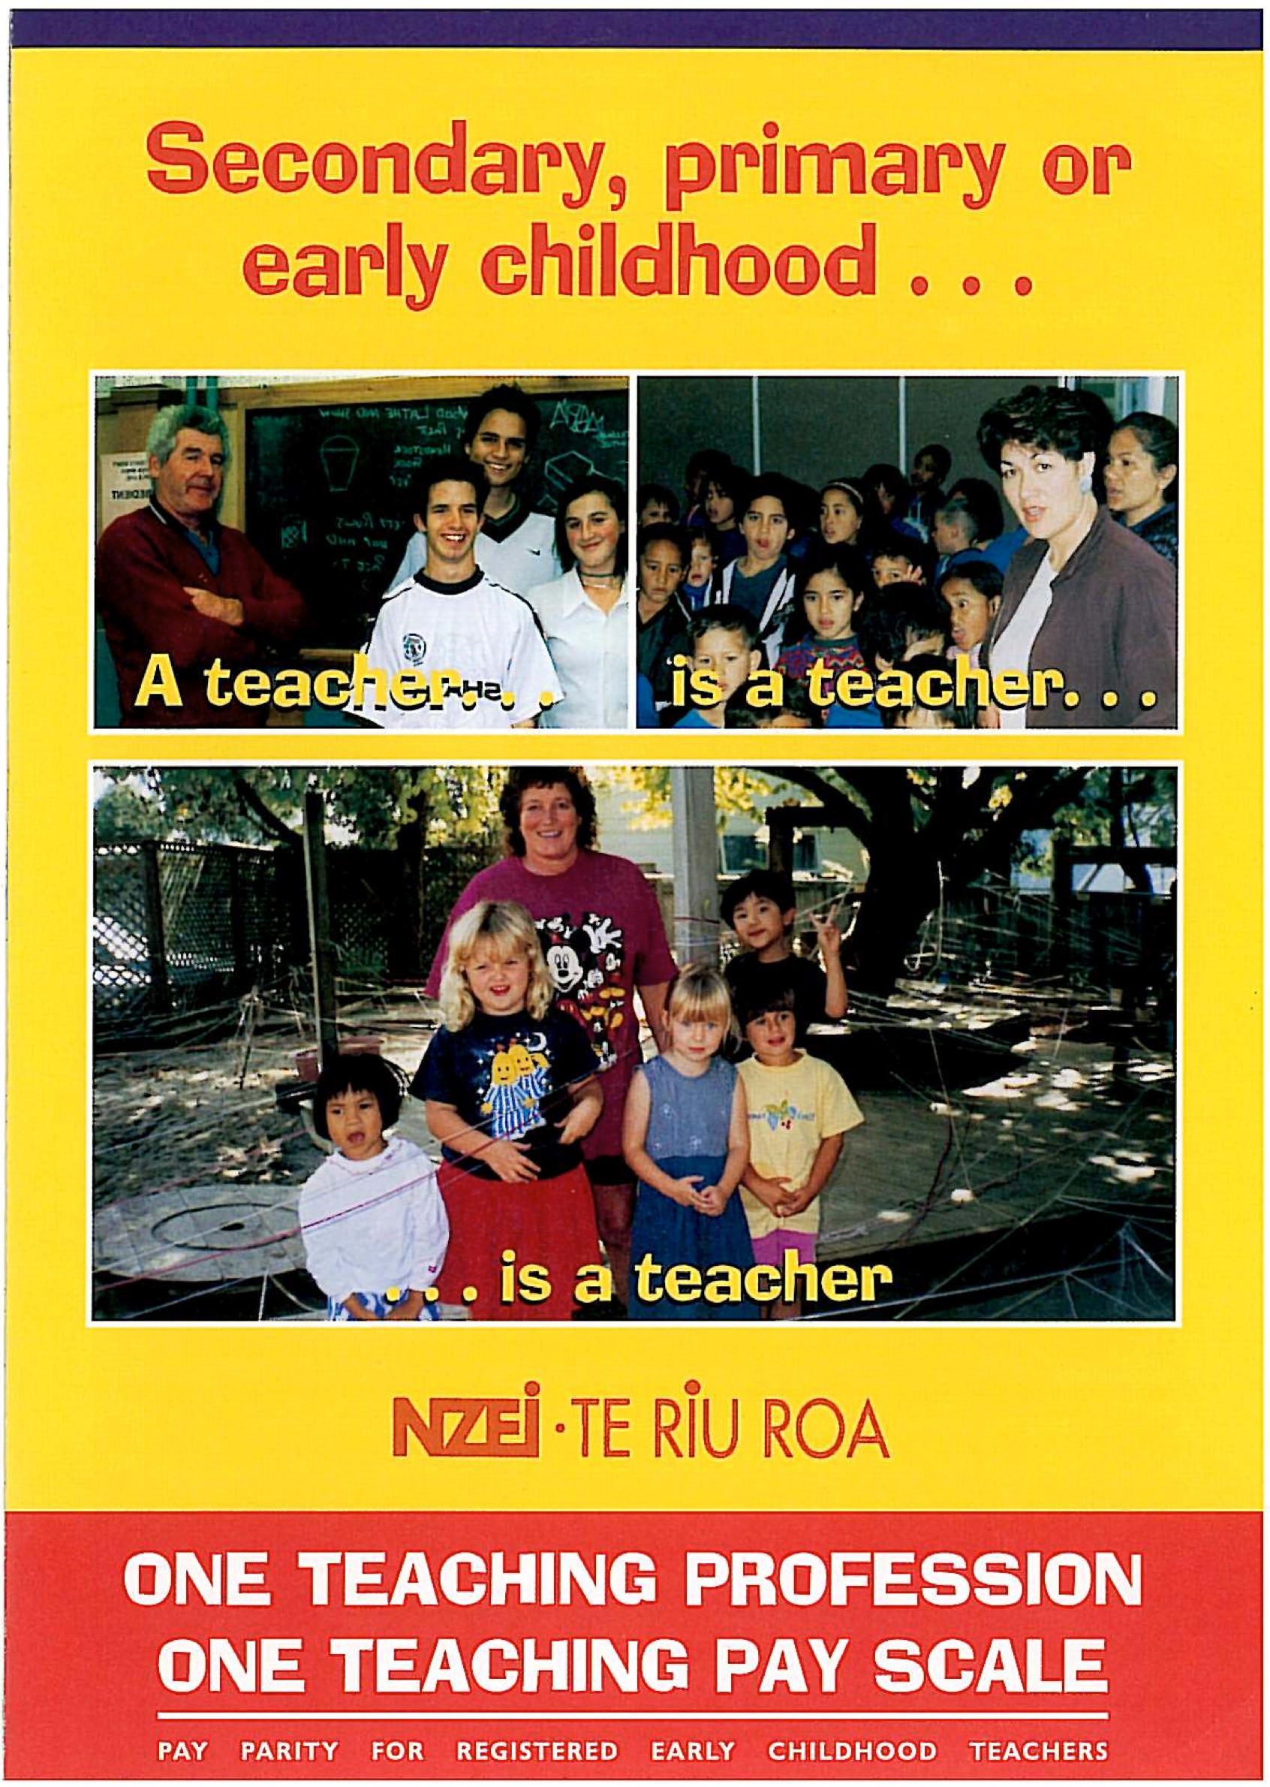
The power of collective advocacy
Notes:
Policy change didn’t happen by chance. New Zealand has a tradition of working collaboratively in advocacy –advocacy woven through the policy gains. The original integration of care and education took 12 years of advocacy that started in the women’s movement of the 1970s – it was women who demanded high quality education and care for their children while they took part in paid employment, and women who organised to achieve this.
The blueprint for policy that we called “Future Directions” – was a remarkable feat in collaborating and getting policy consensus from nine different national early childhood organisations representing the diverse community-based sector. 1996. Sick of enduring cuts and lurching from one government budget to next. Developed own plan through consultation. Turned table on govt officials by calling for their submissions. We created new aspirations and language which in the end became the political mainstream, and set the agenda for the first long term strategic plan for early childhood education. The union’s pay parity campaign emphasised the concept of a teacher, whatever sector they teach in.

Slide 8
Theme 2 policy: the uncurtailed growth of the for-profit education and care sector
Notes:
Here straight to the heart of what is problematic in early childhood policy in New Zealand: the policy frameworks that have encouraged an enormous uncurtailed growth of for-profit education and care centres. The lines with an upward trajectory are private education and care centres - the green line; and private homebased services – the orange line. Downward trajectories are community-based education and care centres and homebased services. The growth parallels increases in early childhood funding.
All government funding streams are available to the for-profit sector on the same basis as to the community sector. Includes funding for capital works. Private for-profit centres are able to make financial gains and distribute these to members. Some listed on the share market. Government funding, parent fees and property are lucrative sources for making business profits.
There has been no requirement for planning of new services to meet community needs - any business owner could set up an ECE centre if meet regulatory requirements.

Slide 9

Inequalities in quality and access
Marketisation and privatisation risk deepening, consolidating or widening inequalities of access to ECEC provision and driving qualitative differences between types of provider (Lloyd, 2012, p. 8)
Notes:
Much research, including my own has shown on average for-profit provision is rated lower on indicators of quality, offers poorer staff working conditions and pay, employs lower percentages of qualified teachers, and offers more restricted access than community-based and public provision. To quote
Marketisation and privatisation risk deepening, consolidating or widening inequalities of access to ECEC provision and driving qualitative differences between types of provider (Lloyd, 2012, p. 8)
In New Zealand, the market approach to provision has led to oversupply and undersupply with poorer and rural areas disadvantaged.

Slide 10

Tenets of community-based provision
The service is seen as a community asset and the children, parents, families and community benefit from it
Collectivity, partnership and participation are hallmarks of decision making
The full funding from public resources goes into educating the child and supporting their family
Notes:
Concerned about these inequities, in 2008, the Quality Public Early Childhood Education project group was set up after nine national organisations with an interest in strengthening community-based provision were invited by the union to attend a meeting. The project group met over 6 months. A main concern was that community-based services can’t compete and expand in the same way as business companies because they don’t have access to the same opportunities for raising capital. Developed tenets of community-based provision aligned with principles of democracy.
Then vision, goals and strategies. We called for a national plan for early childhood provision favouring community-based and public ECE throughout New Zealand, as way of moving away from the market approach. Essentially advocating for crucial policy that would help turn the tide on privatised provision.

Slide 11

Theme 3: Impact of COVID-19 on ECE services
Survey of managers
Interviews with managers
Media commentary
Notes:
Third theme, -recent times - draw on my research to give contrasting stories of how the big corporate companies acted during Covid lockdowns compared with a large kindergarten association. We started the research in June 2020, after New Zealand had experienced a series of lockdowns when Covid was first identified in New Zealand. From a survey of managers, interviews with managers and some media commentary.
Highlight some selected findings – role ECE played during lockdowns and alert levels; then key issues that have been brought into focus concerning way ECE is provided and funded, and recommendations for future.
Sent 15 June 2020 – New Zealand had just moved to level 1.
Mitchell, L., Hodgen, E., Meagher-Lundberg, P., & Wells, A. (2020). Impact of Covid-19 on the early childhood education sector in Aotearoa New Zealand: Challenges and opportunities. An initial survey of managers. Retrieved from h
ttps://www.waikato.ac.nz/wmier/centres-and-units/early-years-research/where-have-we-published

Slide 12
Funding during lockdowns 3 and 4
Ministry of Education
Ministry of Education funding continued based on average enrolments
Covid-19 funding - only education and care and homebased applied for this
Wage subsidy (72%)
Rent reduction (16%)
Interest free loan for small businesses (16%)
Notes:
The government provided quite substantive funding for early childhood during the lockdowns. Usual MOE funding based on average enrolments continued. Special funding also available – a wage subsidy, rent reductions from owners and interest free loans. Only managers from education and care sentres applied for these – most for the wage subsidy. (see percentages)

Slide 13
Working in solidarity with workers, families and communities
ECE for children of essential workers
Distance learning under changed conditions
Support for staff wellbeing
Resources and brokering support for families
Sharing expertise with other ECE management
Notes:
During the lockdowns, the government provided funding for homebased care for the children of essential workers. Andrew Gibbons, a New Zealand academic, described the homebased care as work done in “solidarity” with the country and workers, contributing to the national aims and efforts to stop Covid spreading. “Solidarity” with families and children continued through face-to-face and online learning and advice. Solidarity with colleagues in some settings where regular check in and counselling were wanted.
Some managers of community based services went out of their way to broker social, health and financial support for families. So in our follow-up interview we heard for example of Whanau Manaaki Kindergartens, a large kindergarten association, that went out and got funding for food vouchers, and delivered these to families who were having tough financial struggles. And also helping families to connect with external agencies, such as a mum from a refugee background who had very limited English and needed to contact her landlord over a leaking toilet that was coming down her wall from an upstairs flat. She rang her kindergarten community navigator who spoke her language, Arabic, and helped her get action from the city council.
Findings can be used to argue ECE is a critical element of social and education policy that can play a crucial role in post-pandemic recovery – needs to be seen as a public service and funded and treated accordingly.

Slide 14
Employment actions taken by education and care management during lockdowns
Employment actions | Education and care n=141 (%)
Reduce staff hours | 35 (25%)
Not fill permanent vacancies | 32 (23%)
Make some permanent staff redundant | 10 (7%)
Reduce staff pay | 6 (4%)
Notes:
Contrast with employment actions taken by education and care management. Despite financial support, 25 percent of managers in education and care centres reported that they reduced staff hours, 23% did not fill permanent vacancies, some made staff redundant and reduced staff pay.
Turn to 2 issues related to the big corporate companies in New Zealand –unfair employment practices and treatment of staff during this time; - Capacity to make money through dodgy financial practices.

Slide 15
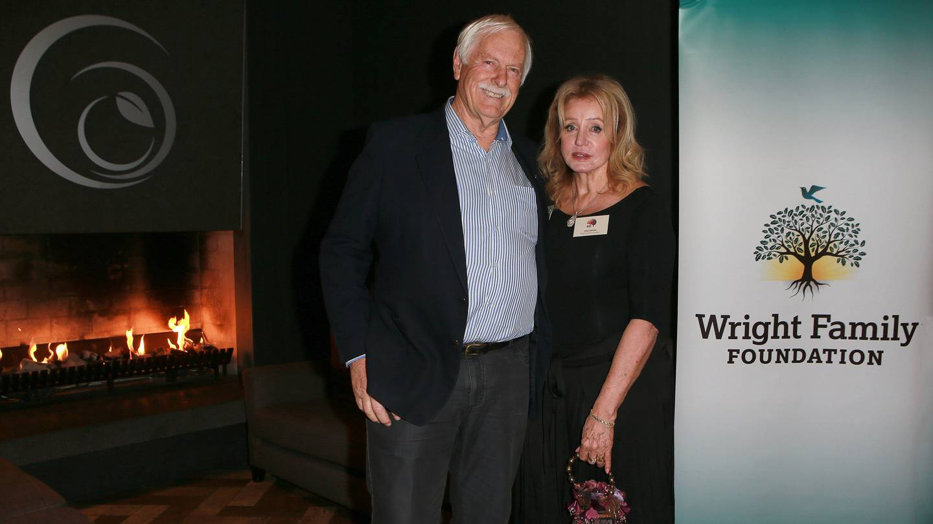
From private corporation to charitable family trust
Childcare giant Best Start audit triggers $7m tax bill (NZ Herald, 15 April, 2021)
Complex financial engineering
Family owners sold their shares to their family run charity (WFF)
WFF repaid purchase through interest free loan from now tax free earnings
Quarter of rent payments to family owned entities
$200m per year government EC funding; $26.9m wage subsidies.
Notes:
Best Start is the largest corporate company in New Zealand. Its status was changed from a private corporation named ‘Kidicorp by founders (pictured), to a registered charitable trust operated by the Wright Family Trust in 2015. The centres were renamed ‘Best Start Educare’. Bay of Plenty Times described ‘Complex financial engineering’ behind this transformation, in which the Wright family sold Kidicorp’s shares to their family-run charity ——for $332m, with the purchase settled through regular repayments of an interest-free loan from now tax free earnings. Audit investigation in 2021, found $7m owing in an amended 2015 income tax assessment. A quarter of rent payments are to family owned enterprises ($8.6m). Makes huge amounts in government funding – estimated $200m per year, claimed very large wage subsidies ($26.9m) during lockdowns.
(The Bay of Plenty Times, 15 April, 2022).

Slide 16



During the Covid-19 lockdown Evolve received wage subsidies of $12 million, continued government ECE funding subsidies, and at the same time, offered full-time staff illegal 20-hour contracts, with a requirement to be on-call (unpaid) for a further 20 hours, in case they were needed.
Notes:
Evolve is the second largest company in New Zealand, owning 111education and care centres in New Zealand and 21 in Australia. During the Covid-19 lockdown it received wage subsidies of $12 million, continued government ECE funding subsidies, and at the same time, offeedr full-time staff illegal 20-hour contracts, with a requirement to be on-call (unpaid) for a further 20 hours, in case they were needed. At the same time, plans were being made for expansion, and its companies statements reported a stronger overall financial position.

Slide 17

Busy Bees Childcare
75 settings in New Zealand, 365 in UK, 153 in Australia, 417 in Europe, 127, North America, 83 Asia (Nursery World, 2021)
CEO of Australian company, Think, made $44 million selling his shares to Busy Bees. (Spitting off the cash, p. 14)
Notes:
Busy Bees Childcare is the third largest provider of education and care centres in New Zealand, after buying 75 ECE centres in New Zealand. It owns centres around the world. Busy Bees has been exposed in a report by the United Workers Union in Australia, for paying exorbitant salaries to owners and executives and avoiding tax by paying the parent company offshore and registering a debt. The UCL report Acquisitions, Mergers and Debt: the new language of childcare — Main Report ¹ included Busy Bees. Similar and further findings, including that staff costs could be as much as 14 per cent lower than the not-for-profit sector – Helen and Eva?

Slide 18
ECE rollup. Expansion in New Zealand through acquisitions ‘and exit’
We're going to dominate the fragmented early childhood education industry in New Zealand through acquisition growth with commercial debt, equity and vendor finance.
Our goal is to consolidate 100 facilities in the early childhood education sector & exit.
Early childhood education has performed extremely well . . .
We have a group of experienced Board of Directors specialising in early childhood education, legal, finance, accounting and mergers & acquisitions.
(Institute of Directors advertisement for position of chair, February, 2022)
Notes:
ECE rollup. Expansion in New Zealand through acquisitions ‘and exit’
Finally, this advertisement placed by the Institute of Directors New Zealand, in February 2022, for the position of Chair for an “ECE Rollup”. Motivation to expand through acquisitions not development of new places, make money and get out.
We're going to dominate the fragmented early childhood education industry in New Zealand through acquisition growth with commercial debt, equity and vendor finance.
Our goal is to consolidate 100 facilities in the early childhood education sector & exit.
Early childhood education has performed extremely well, with 5000 facilities & 100 - 150 new facilities being built in New Zealand for the last 5 years.
We have a group of experienced Board of Directors specialising in early childhood education, legal, finance, accounting and mergers & acquisitions.

Slide 19

Theme 4: Early Learning Action Plan
Early learning services are part of a planned and coherent education ecosystem that is supported, accountable and sustainable.
Regulate for 80 % qualified teachers in teacher-led centres, leading to regulation for 100 %.
A mechanism that improves the levels and consistency of teachers’ salaries and conditions across the early learning sector.
Notes:
Minister of Education, promised to “turn the tide on a a privatized profit-focused education system”. What was developed - another strategic plan – the Early Learning Action Plan. On working group – vociferous arguments with EC Council representing many private EC centres about private ECE and how to privilege public and community services.
These 3 promising goals published:
1. introducing a managed network approach where any new centre needs to have ministerial approval and meet criteria. This is drafted in an Education Bill and a select committee is looking at submissions. A radical change from letting the market decide whether and where provision is needed - just a beginning step.
Two other steps –i) regulated for 80 percent of staff in ECE to be qualified teachers. Ii). Some steps to achieving pay parity for all teachers – through funding tied to employers paying teachers on the kindergarten pay scale.
Capacity for profit-making curtailed - staffing biggest cost, where profits made.

Slide 20
Way forward
Turn the tide on privatised, profit-focused provision, re-asserting ECE as a public good and collective responsibility:
Require structures to include community, parent and teacher representatives as full decision-makers
Remove eligibility for capital works and properties funding from for-profit centres
Cap fees and monitor enrolment policies
Require full accountability for spending of all funding
Pay parity for all ECE teachers, Ministry of Education a party to collective agreement
Plan new provision and restrict it to community and public ECE.
Notes:
Putting forward an alternative story is dismissed by entrepreneurs and many in the sector, as out of touch with reality, that we have gone too far down the road of privatisation, that the neoliberal discourse has taken hold to such an extreme that it is impossible to turn back. Like Peter Moss, I believe that privatised provision is reversible, there are alternatives, it is a matter of political will. For a democratic system of early childhood education we need to, in the Minister of Education’s words, turn the tide on privatised profit-focused provision. For immediate steps we can learn from enlightened policies in European and other countries:
Require structures to include community, parent and teacher representatives as full decision-makers
Remove eligibility for capital works and properties funding from for-profit centres
Cap fees and monitor enrolment policies
Require full accountability for spending of all funding
Pay parity for ECE teachers, Ministry of Education a party to collective agreement – teachers are public servants
Plan new provision and restrict it to community and public ECE.

Slide 21
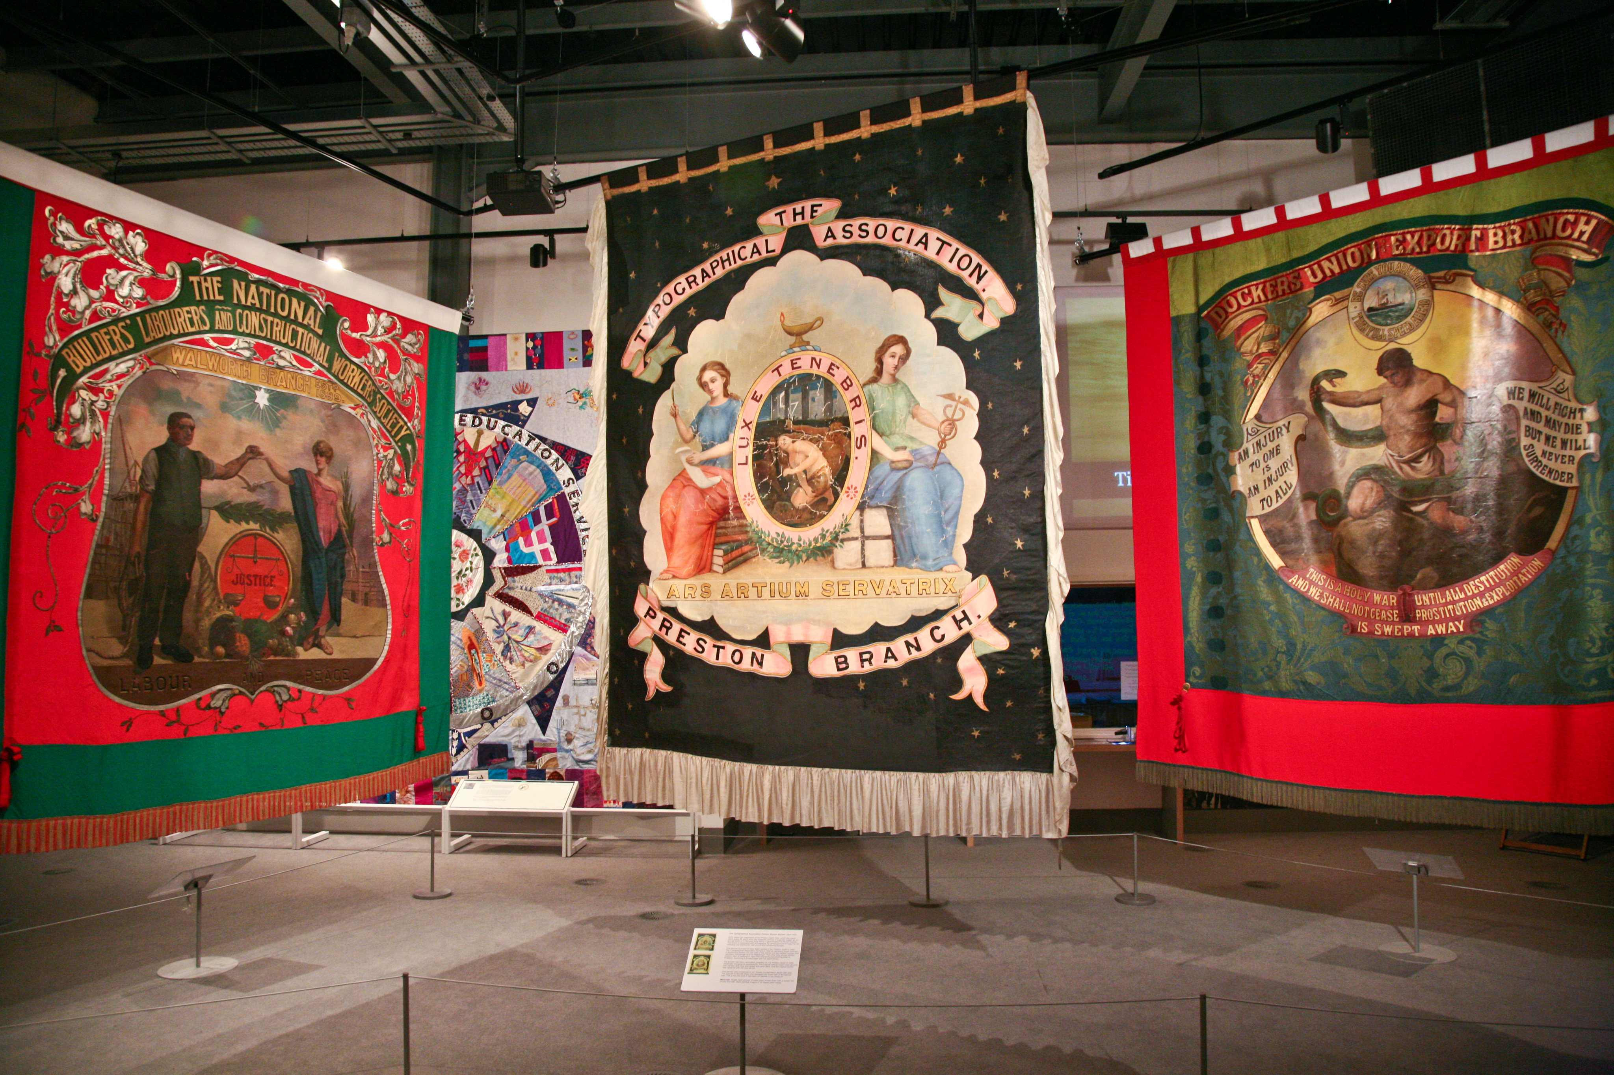
Democratically organised networks, effective unions
and community associations
Notes:
New Zealand examples illustrate that democratically organised networks, effective unions and community associations, can provide a means to organise, give voice to, and persist in a collective effort to progress ideals for ECE as a public good and for a well supported, well educated, and well paid ECE workforce. They organised together to bring about new thinking. Advocacy went beyond workforce employment conditions, to ‘big’ questions about the role of education, arguments for ECE as a public good, and questions of social justice for children and families.
A challenge is to maximise the potential of such coalitions to critically question and change structural relationships so that those who dominate politically do not hold the power to assert neoliberal solutions.

