Slide 1





COVID health behaviour non-compliance as `playful’ oppositionalism and implications for public health strategy
Professor Mark McDermott,
University of East London, Department of Psychological Sciences, UK
m.r.mcdermott@uel.ac.uk
&
Dr. Kathryn Lafreniere,
University of Windsor, Department of Psychology, Canada
lafren1@uwindsor.ca
  2020 Virtual NIHR MindTech Symposium: Digital Mental Health
  in the Age of COVID-19; 3rd December 2020.
University of
Windsor

Slide 2

University of
Windsor
What we did:
We conducted an online survey (via the Qualtrics platform) of N=666 respondents from one province, Ontario, in Canada.
Self-report data addressed: health belief model variables, rebelliousness, demographics, and compliance with covid public health behaviours – including mask wearing, hand washing, social distancing.

Slide 3
University of
Windsor
What we found:
it is not the disaffected `reactive’ form of rebelliousness that predicts non-compliance with mask wearing, social distancing and hand washing.
it is the `proactive’, excitement-seeking, breaking-rules-in-the-moment-for-`fun’ type of rebelliousness that emerged in statistical regression analysis as an independent predictor (along notably with `conservative’, rather than liberal, political orientation).

Slide 4
University of
Windsor
What we concluded:
People break covid rules not because they are `fed-up’ with them (a popular media narrative).
The rules are opposed in the moment to provide a mini-thrill, an attention-seeking `look at me, aren’t I naughty/a rebel’ sensation.
So, CV19 non-compliance has more to do with social identity as a `non-conformist’ than it does with being truly disaffected with the imposed health behaviour requirements.

Slide 5
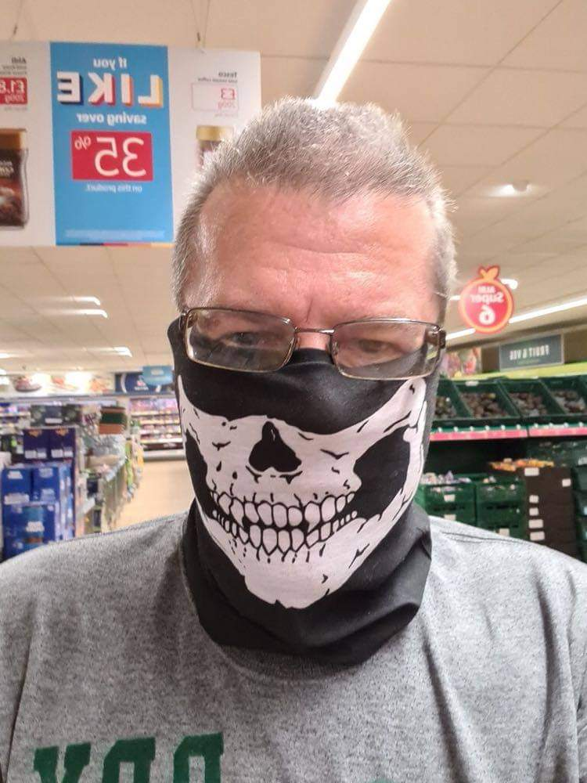
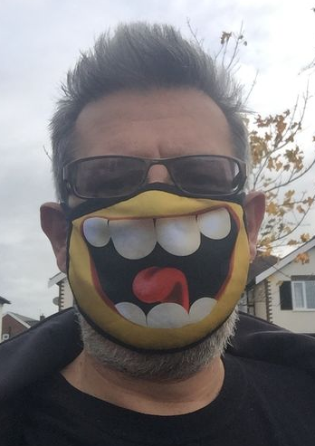
University of
Windsor
What we recommend:
Public health messages need to be constructed which nudge playful CV19 rebels toward compliance.
Those who proactively rebel against covid rules can be encouraged to `get their kicks’ in other ways.
For example, providing playfully oppositional imagery on face masks may encourage non-compliers to wear them.
Such masks signal the wearer’s rebellious social identity
but without putting themselves or others at risk.
THANK YOU FOR YOUR ATTENTION.

